Slide 1
GAN-101
Done by:
Goh Rui Zhuo (2222329) & Toh Kien Yu (2222291)

Slide 2
Table of contents
01
02
03
04
05
06
07
Background Research & Feature Engineering
Exploratory Data Analysis
Application of GAN
GAN Architectures
Evaluation
Model Improvement
Final Model

Slide 3
01
Background Research & Feature Engineering

Slide 4
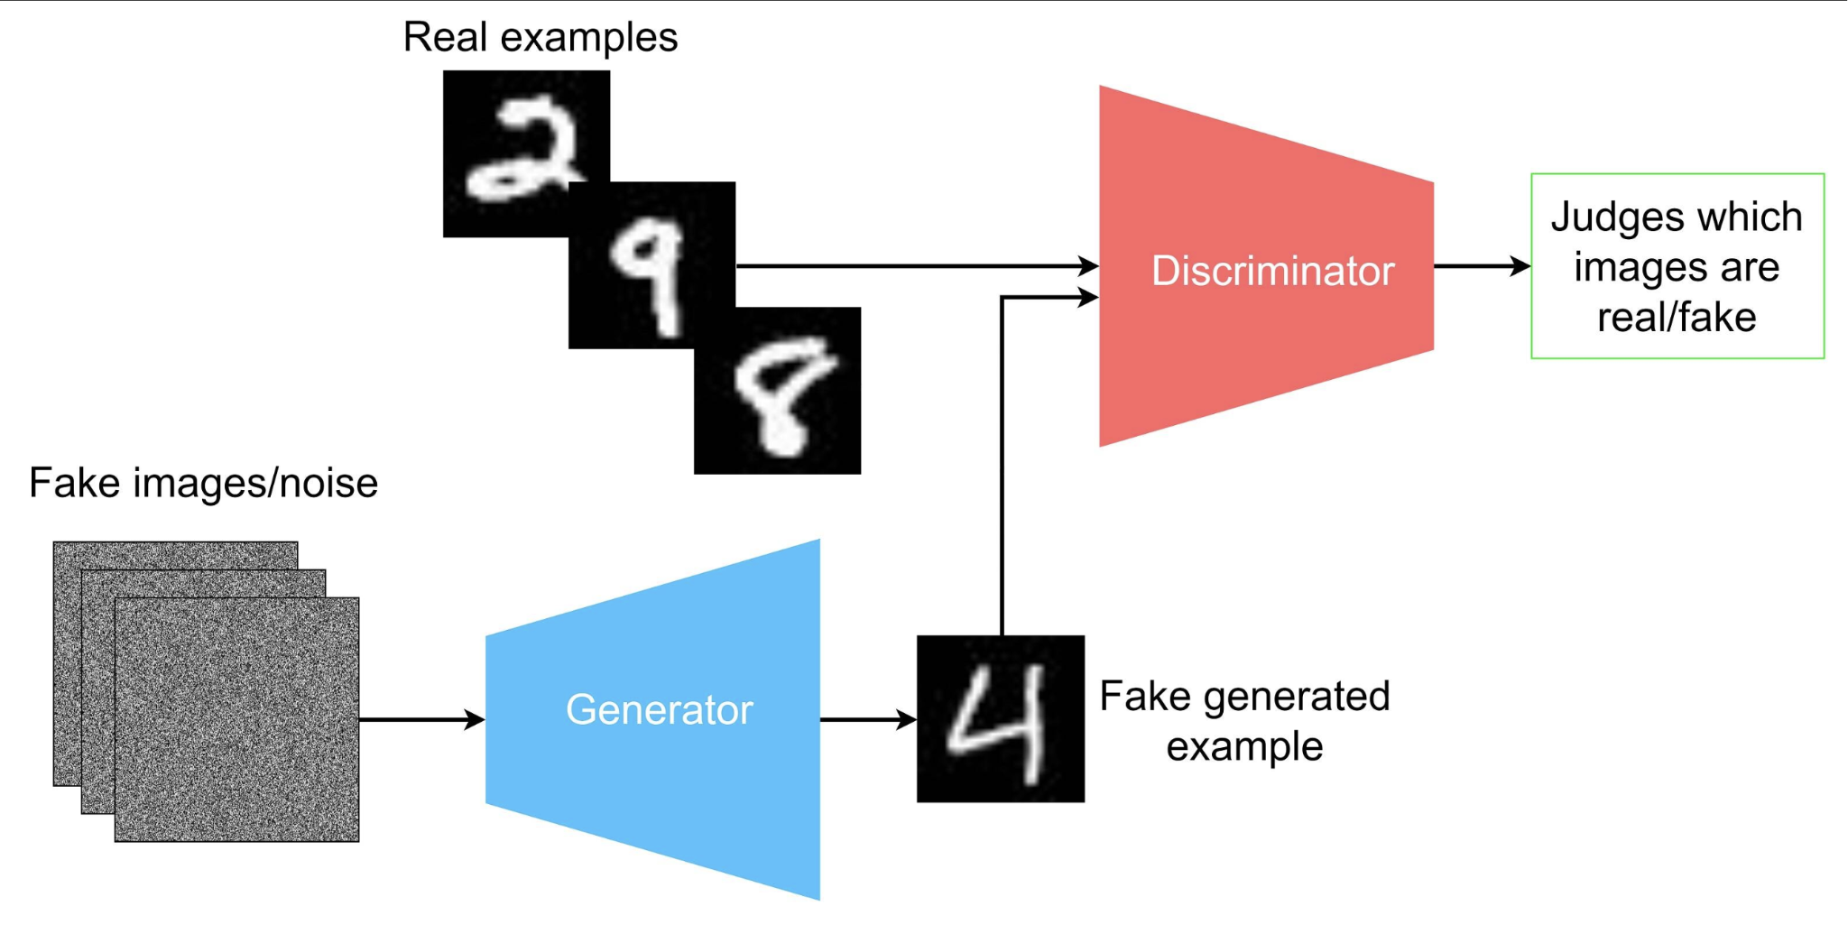
Background Research
What is GAN?
Gan represents Generative Adversarial Networks which is all about creating here. Generally it is harder compared to other deep learning fields.
The main focus of GAN is to generate data be it images or videos or music from scratch and generally what does GAN consist of?
GAN are algorithmic architectures that uses 2 neural networks, putting one against the other. This is to generate new, synthetic instances of data that can be pass as real data.
Generally, widely use in image generation, voice generation etc.
GAN also work with competition of two different parts

Slide 5
Background Research
Generator
For this, you can input random images, known as random noise. This random images can be anything.
Through the generator, it will generate a sample that hopefully ends up like the real dataset if the generator and discriminator and discriminator both are trained good enough
Output is sometimes referred to as latent space or a latent vector
Discriminator
For discriminator, input the real images from actual data that needs to be generated like CIFAR10
Also, you input the output of generator into the discriminator
Convolutional layer of discriminator is the normal convolution we are used to.
This are downscaled to the input that is suitable for classification.
How can we optimise as a whole?
After data is passed through both generator and discriminator, optimisation with backpropagation begins, the goal is to keep improving at a level pace for both models to be good at its role, equilibrium point is exactly when the discriminator is leaning 50% to both sides, meaning that both images could either be real or fake, where the generator model tries to minimize the probability that the discriminator will predict the generator's output as fake. On the other side, the discriminator tries to maximize the probability that it will correctly classify both real and fake image

Slide 6
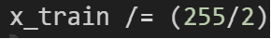
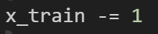
Feature Engineering
Convert Data Type
This line converts the data type of x_train elements to float32. It's a standard practice to use floating-point numbers in computations involving neural networks due to their capability to represent decimal values, which are crucial for the granularity of learning.
2. Scale The Data
Here, the pixel values of the images (assuming `x_train` contains image data) are scaled. Usually, image data comes in the format of integers ranging from 0 to 255 (8-bit representation). This operation scales the data to a new range. Dividing by `(255/2)` scales the data to a range of [0, 2].
3. Shift The Data
This operation shifts the data range from [0, 2] to [-1, 1]. Shifting data to be centered around zero (mean = 0) can significantly improve the convergence during training, as it ensures that the input features have similar scales.

Slide 7
02
Exploratory Data Analysis

Slide 8
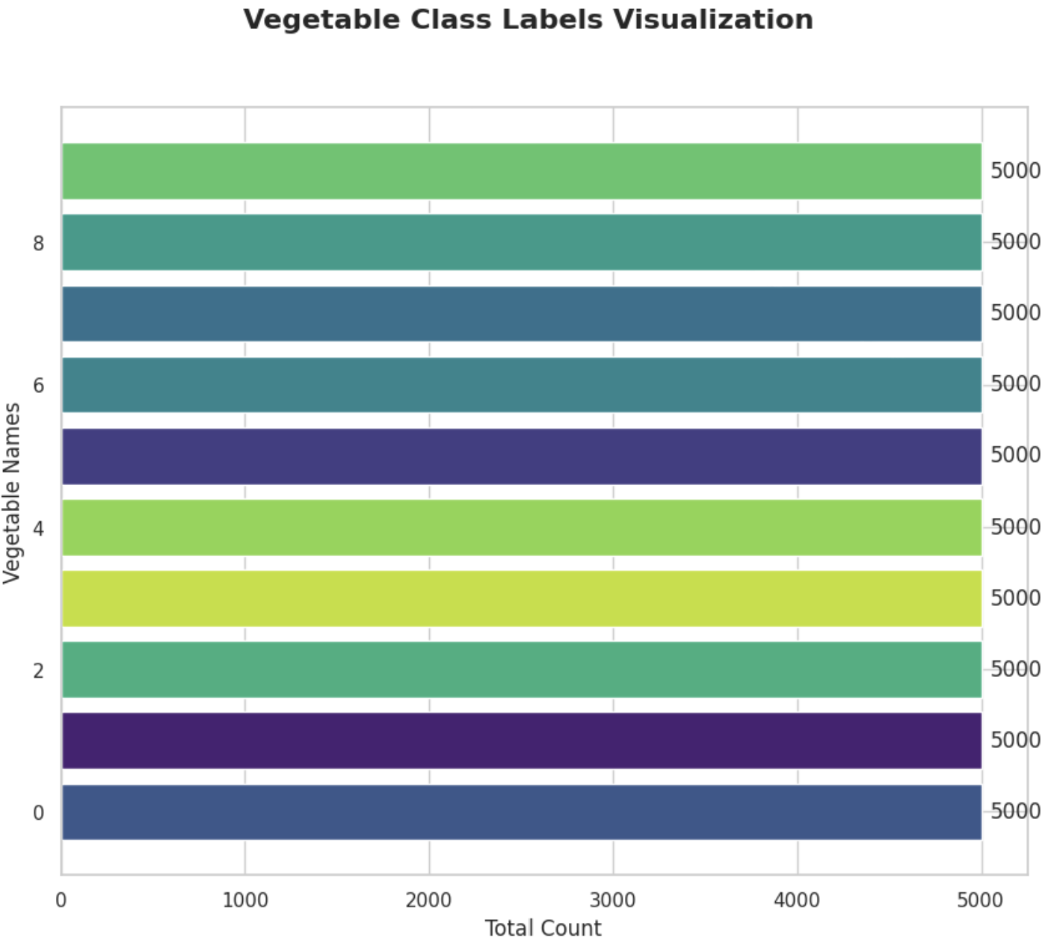
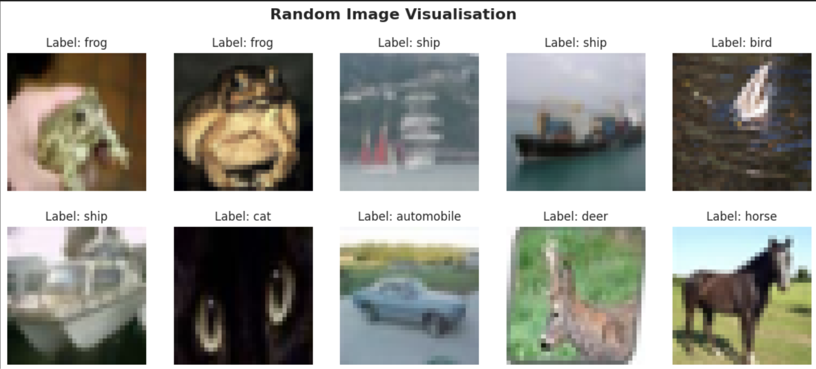
Exploratory Data Analysis
Random Image Visualisation
Process of picking random images and visualise it.
- This provide us a way to inspect our dataset
- To ensure that images are of good quality
Dataset are of pretty good quality

Slide 9
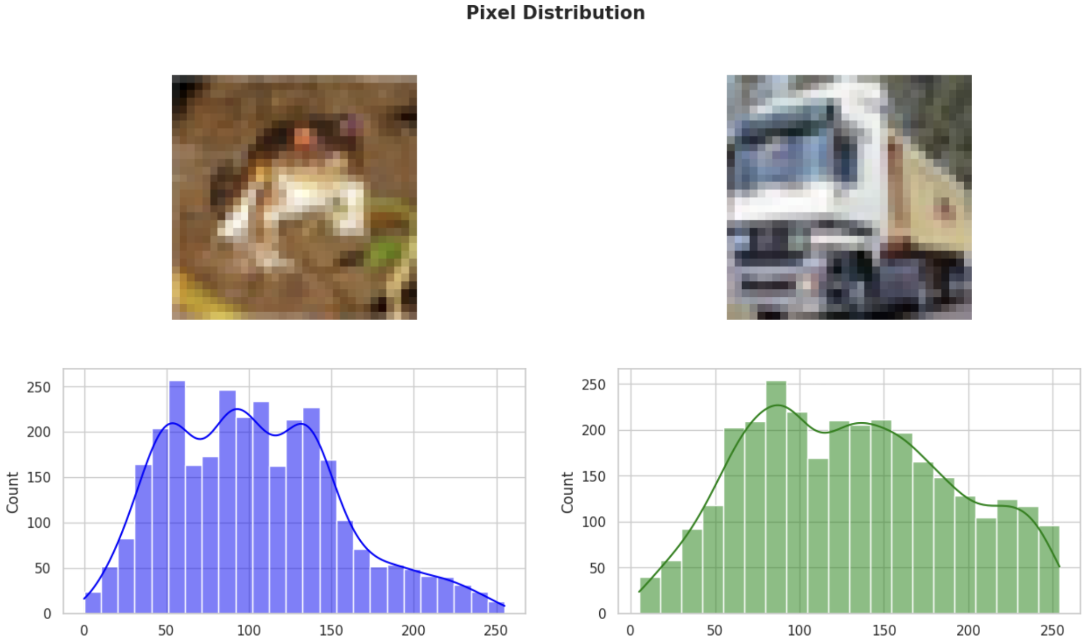
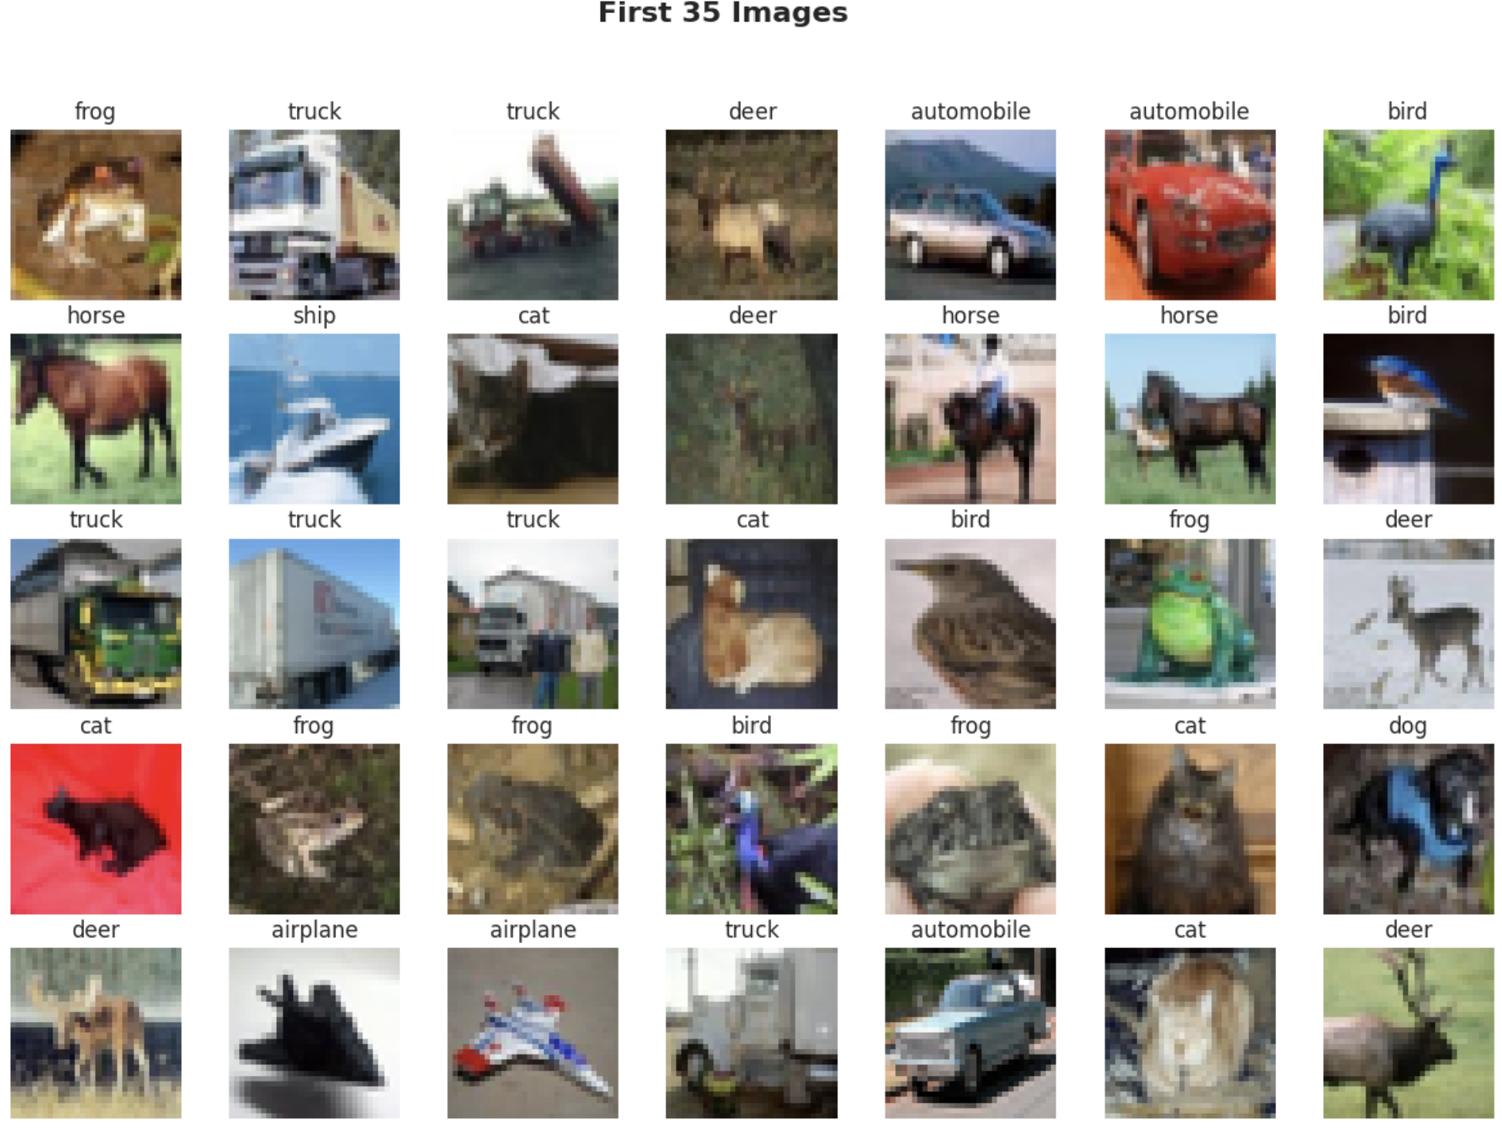
Exploratory Data Analysis
Pixel Distribution
To determine which methods to use for scaling of dataset
1. Check for the distribution of the first to images
35 Image visualisation
Similar to above random visualisation, this is to
- Ensure the images are of good quality
- Check first few images here
Things Observed
First images
Significant variance in colour intensity
Contains peaks at 150
Wide variation of colour intensity
Second Images
Smaller number of green beans on a light background
Histogram for this image shows a significant peak around the 200 intensity level, which corresponds to the light background

Slide 10

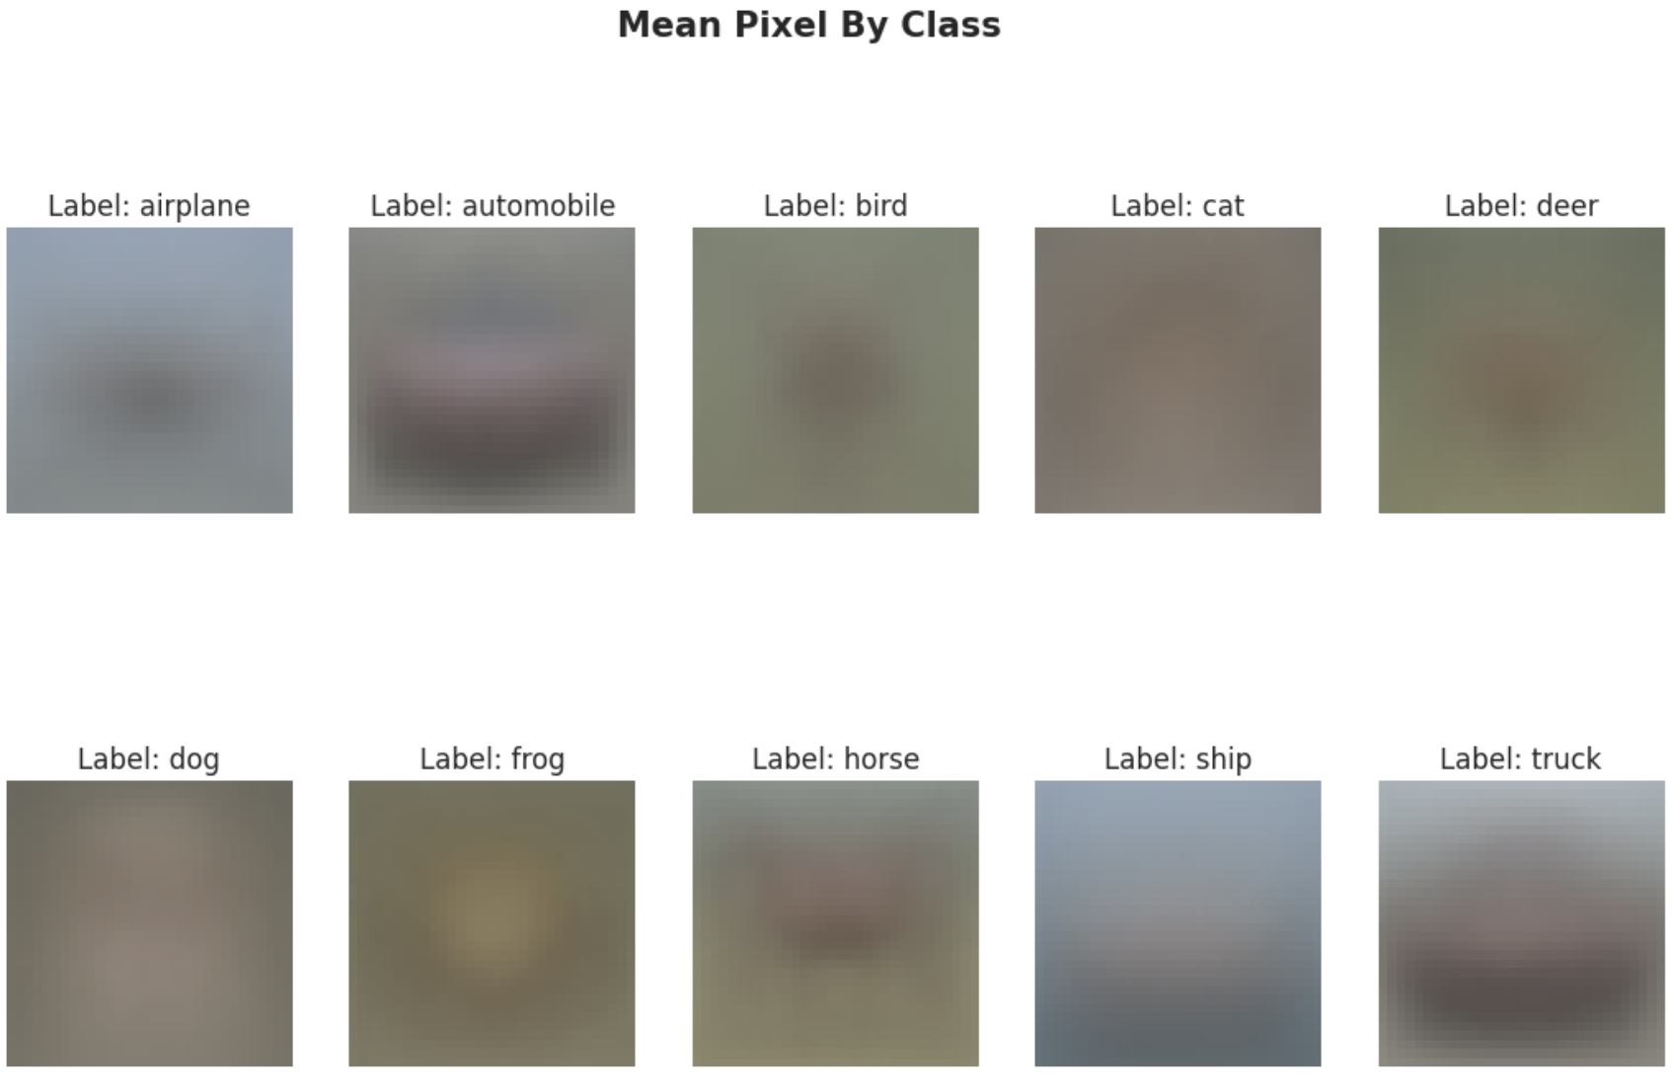
Exploratory Data Analysis
Mean Pixel Distribution
Checking the mean pixel and standard deviation.
Things observed
Overall, the mean image is not as clear here.
Whole Dataset
By Class

Slide 11
03
Application Of GAN + GAN Architecture

Slide 12
Application Of GAN
01
02
03
04
DCGAN
CGAN
WGAN
SAGAN

Slide 13
DCGAN

Slide 14
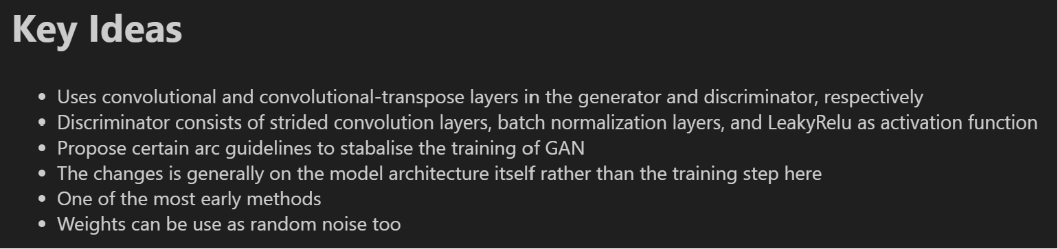
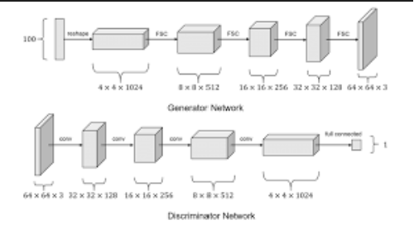
DCGAN

Slide 15
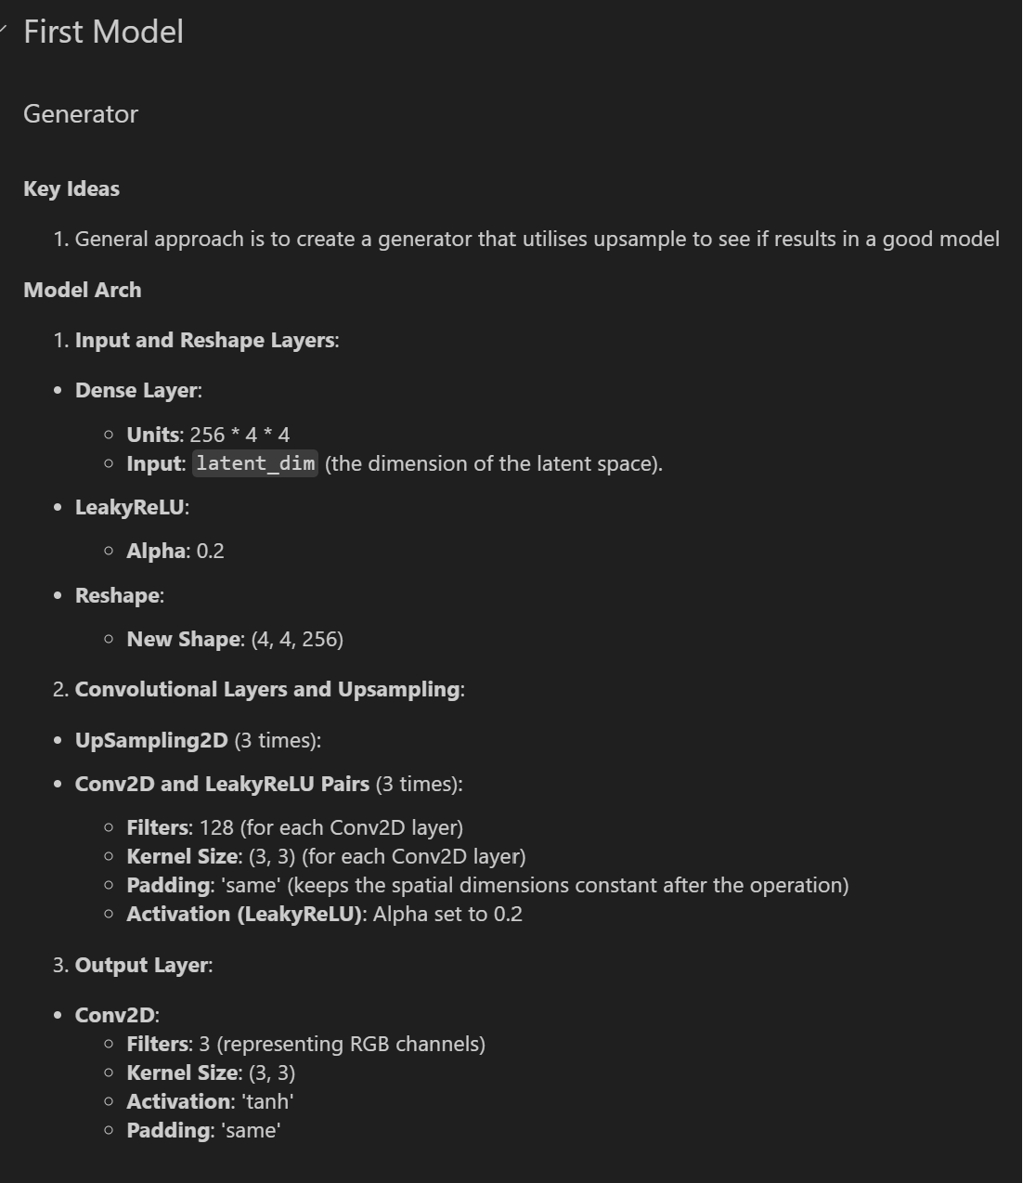
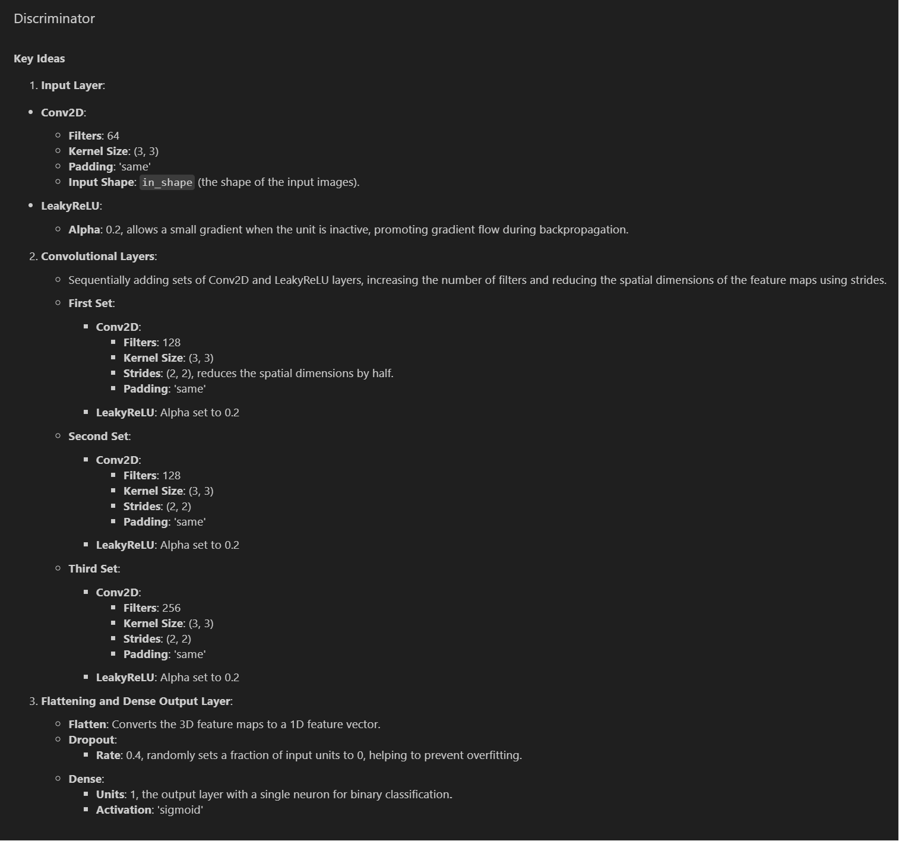
DCGAN (Model 1)

Slide 16
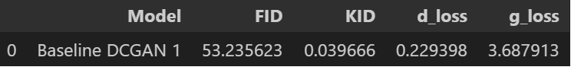
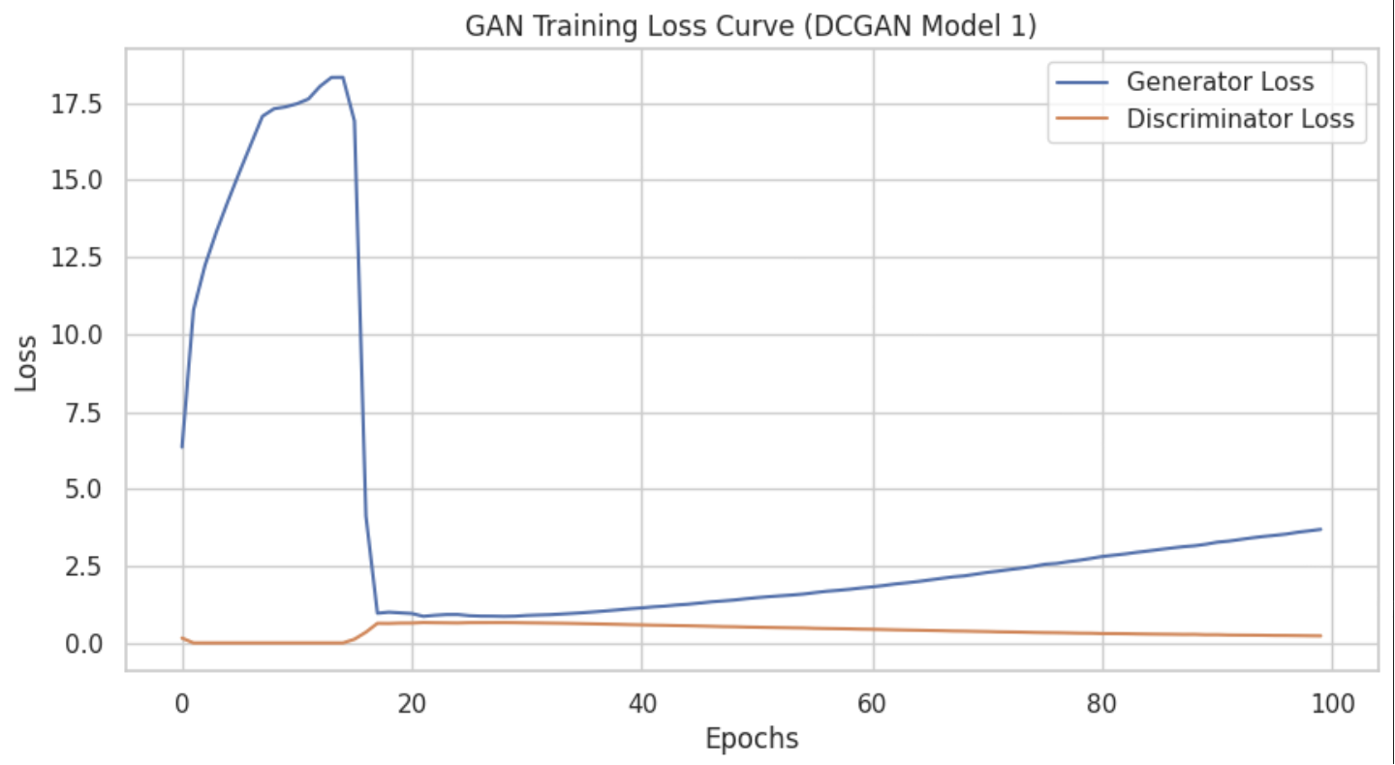
DCGAN (Model 1)
Discriminator loss
For the discriminator loss, it starts relatively low and rises quickly and continues to increase steadily as the epochs increases
Generator loss
For the generator loss, it increases with a spike and drops and proceeded to increase slowly
- FID Score of 53
- KID Score is 0.04
Both are not too good, let us see if we can improve
Generally, we can tell most of the animal images like deer, dog but cars and ships images are not produced

Slide 17
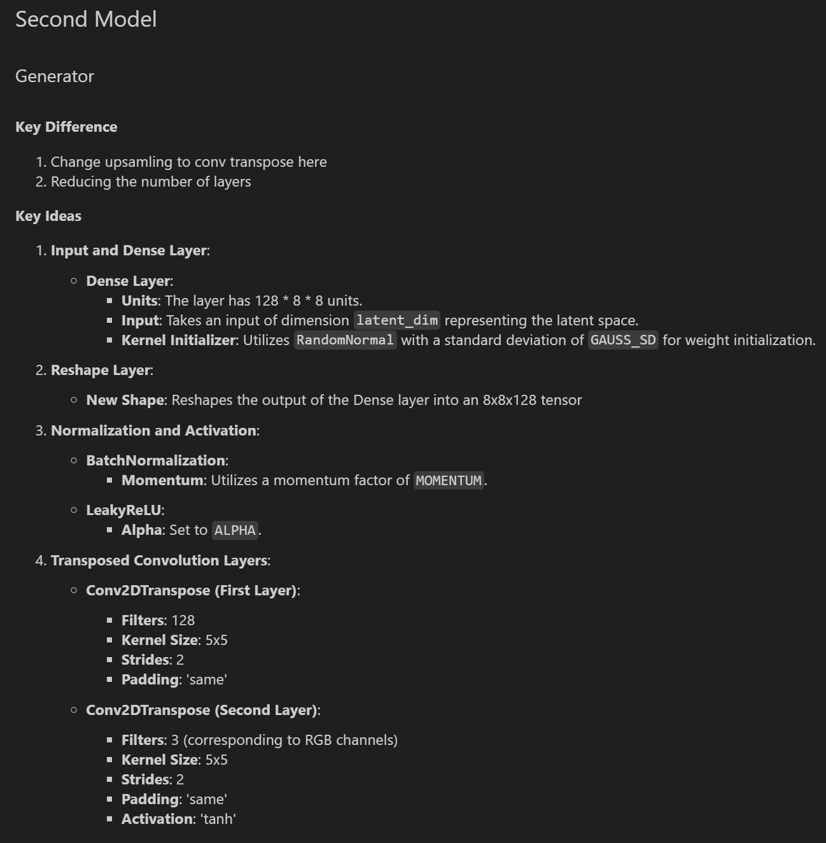
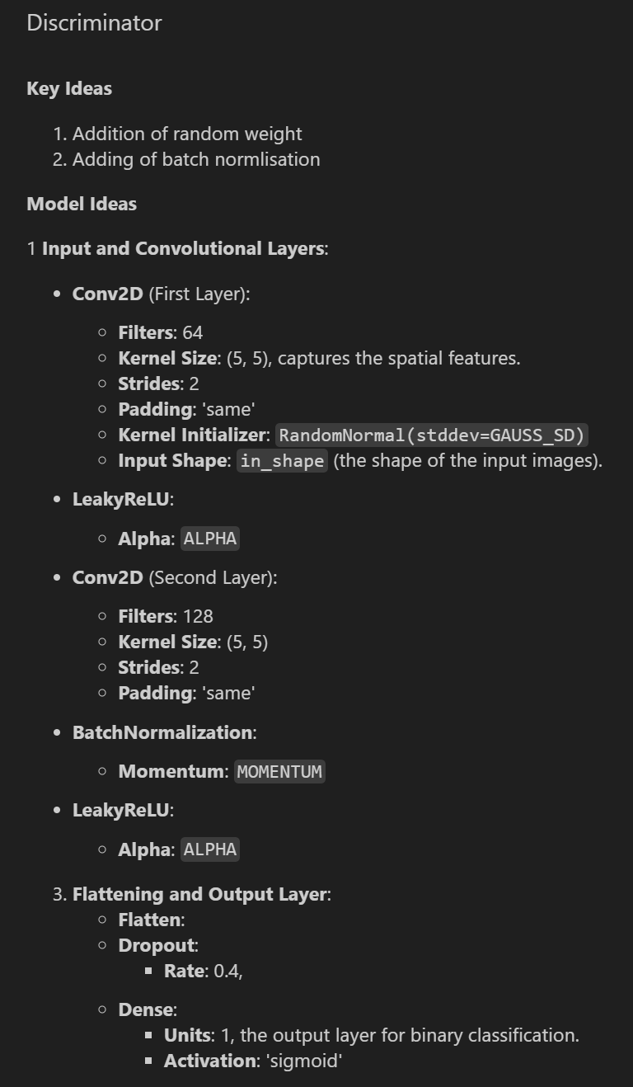
DCGAN (Model 2)

Slide 18
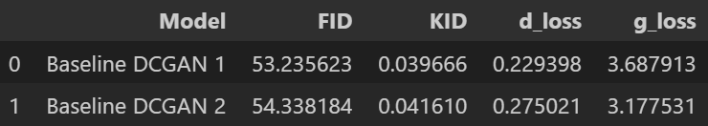
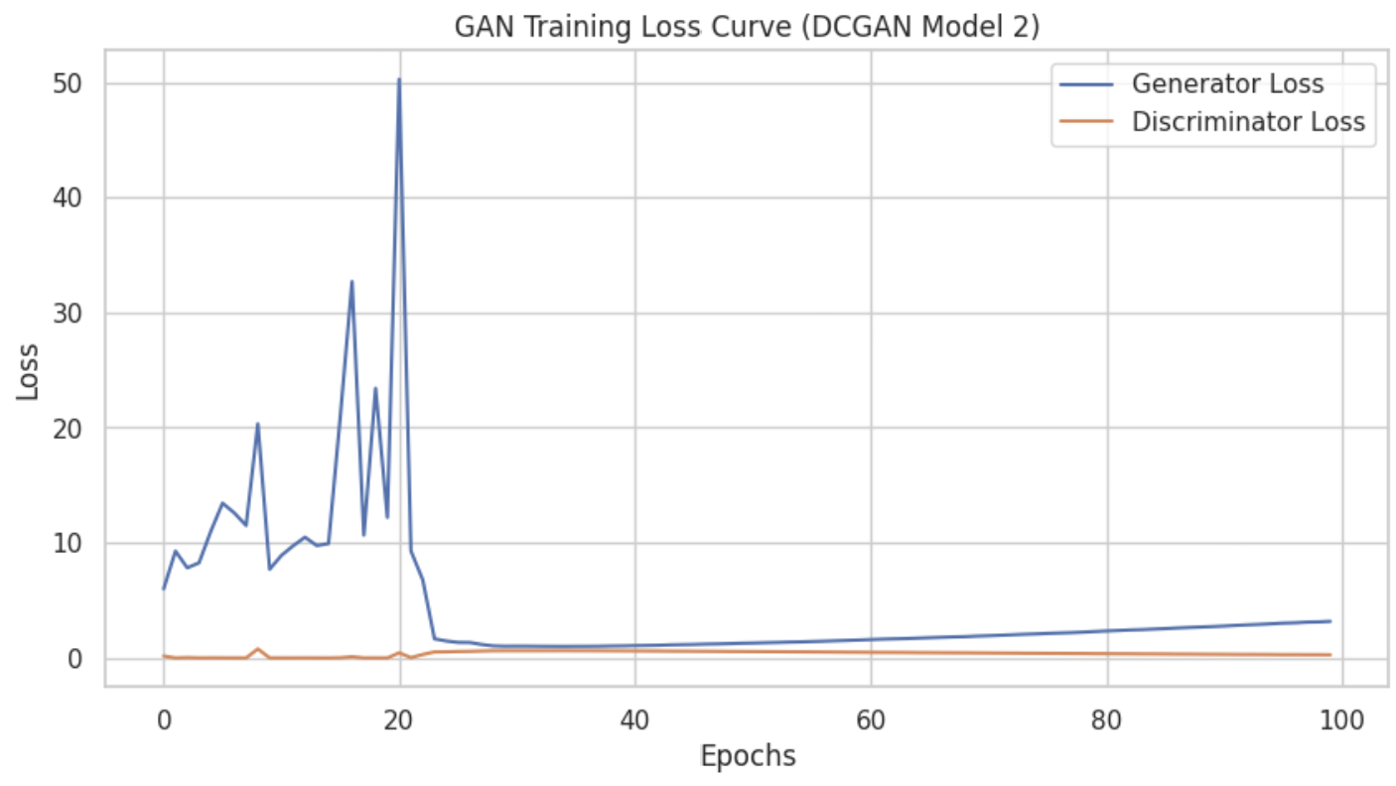
DCGAN (Model 2)
Discriminator loss
For the discriminator loss, it starts relatively low and mains around there
Generator loss
For the generator loss, it increases with a spike and drops and proceeded to increase slowly
- FID Score of 54
- KID Score is 0.04
It did not improve from the previous model, let us keep trying
Similar to above, we can tell most of the animal images like deer, dog but cars and ships images are not produced

Slide 19
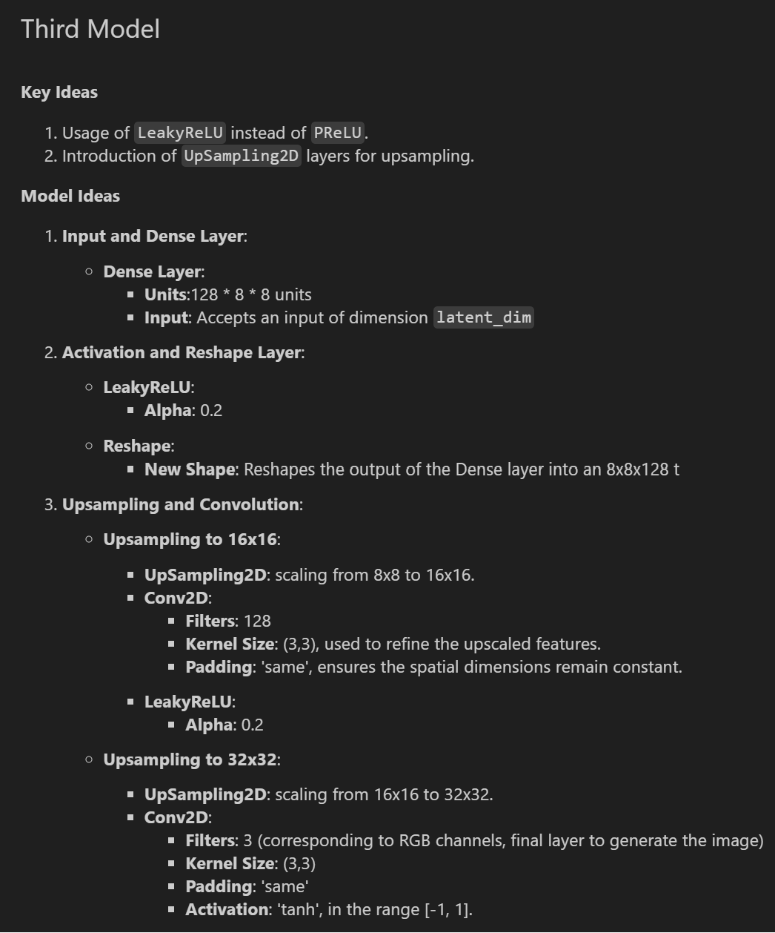
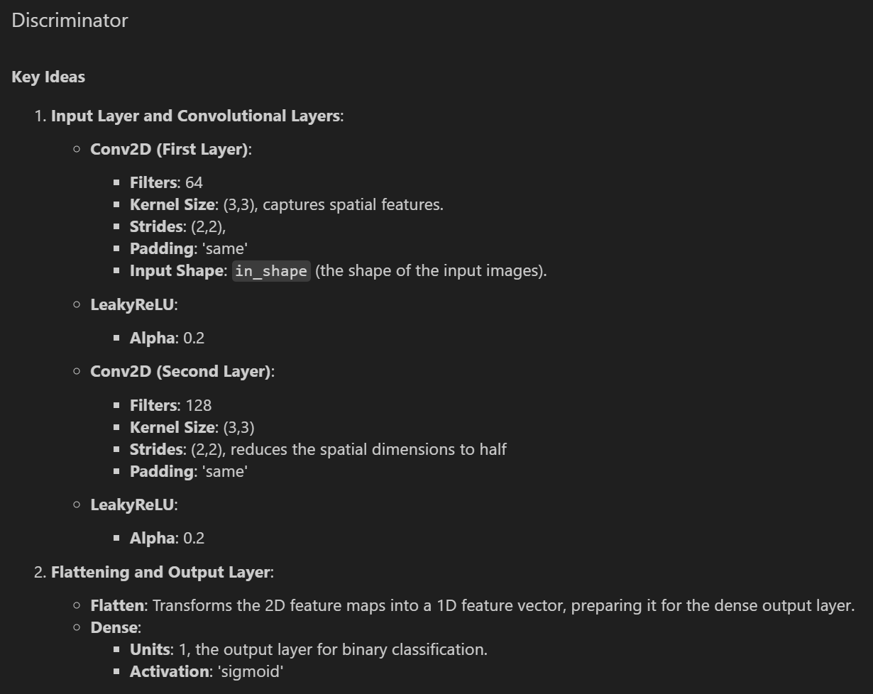
DCGAN (Model 3)

Slide 20
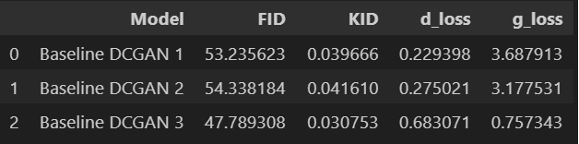
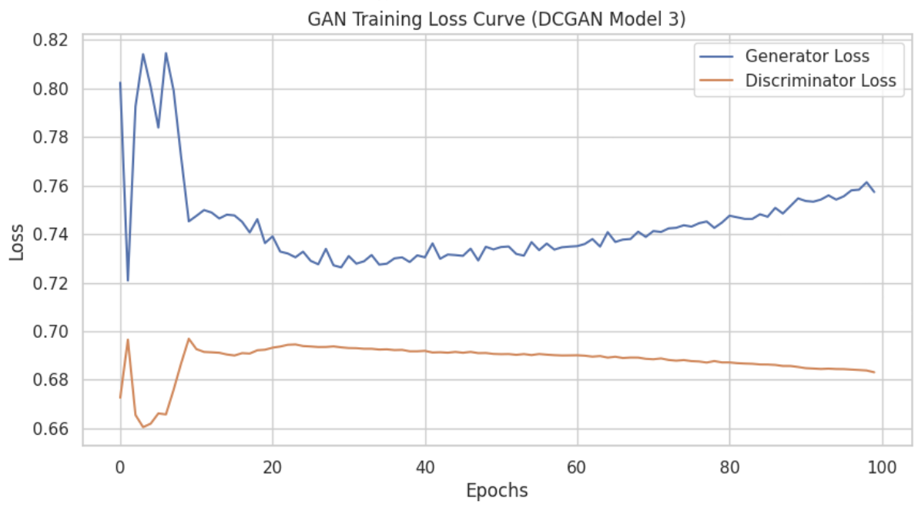
DCGAN (Model 3)
Discriminator loss
For the discriminator loss, it starts relatively low and rises quickly and continues to increase steadily as the epochs increases
Generator loss
For the generator loss, it increases with a spike and drops and proceeded to increase slowly
- FID Score of 47
- KID Score is 0.03
It improved further compared to the previous two models
Generally, we can tell most of the animal images like deer, dog and cars and ships are able to be seen

Slide 21
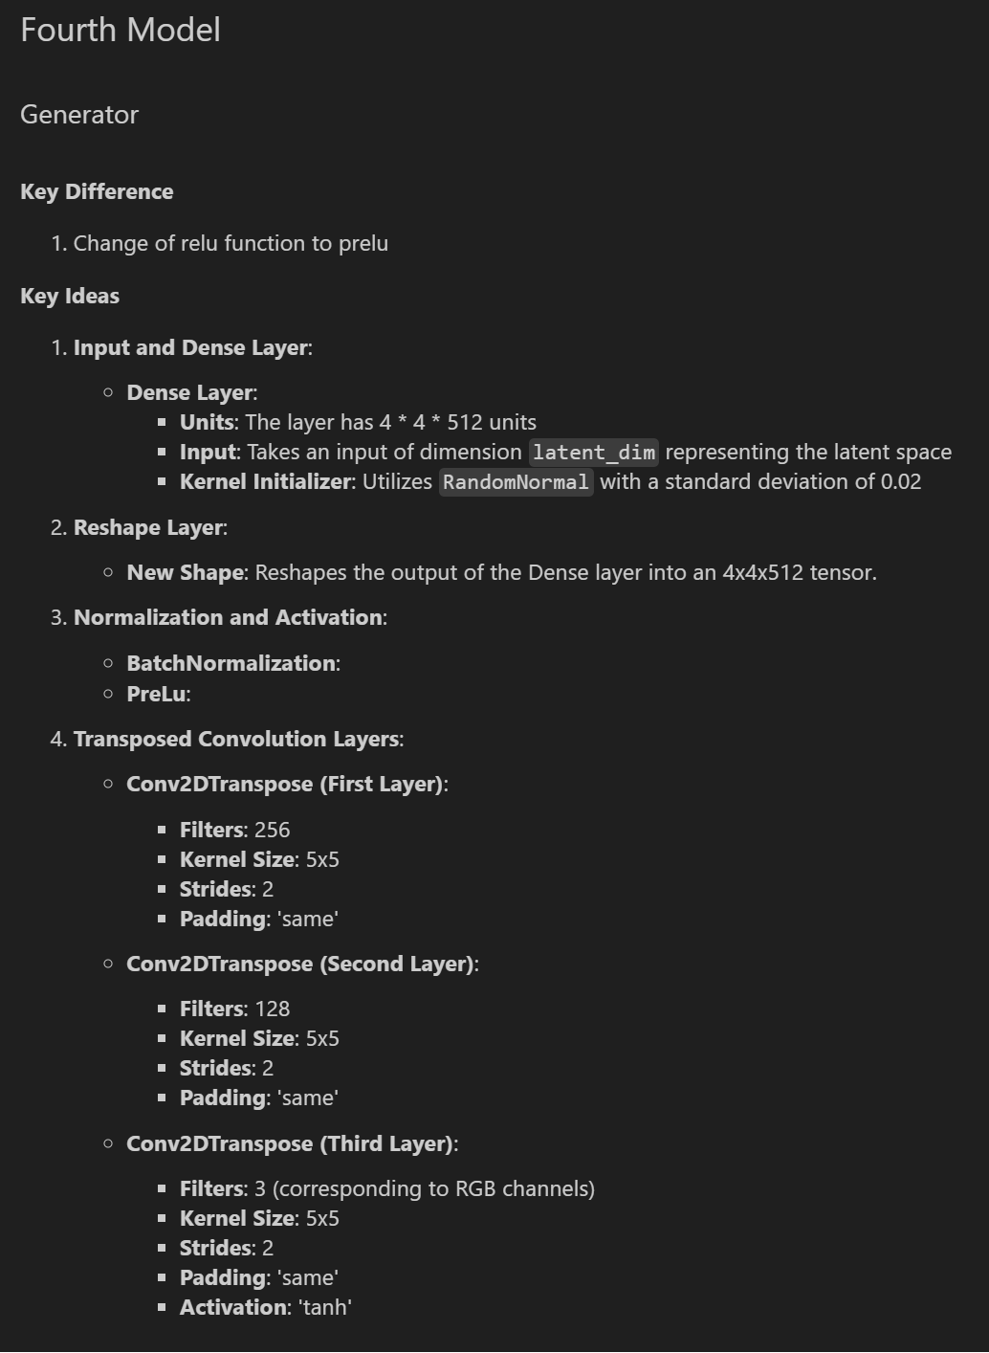
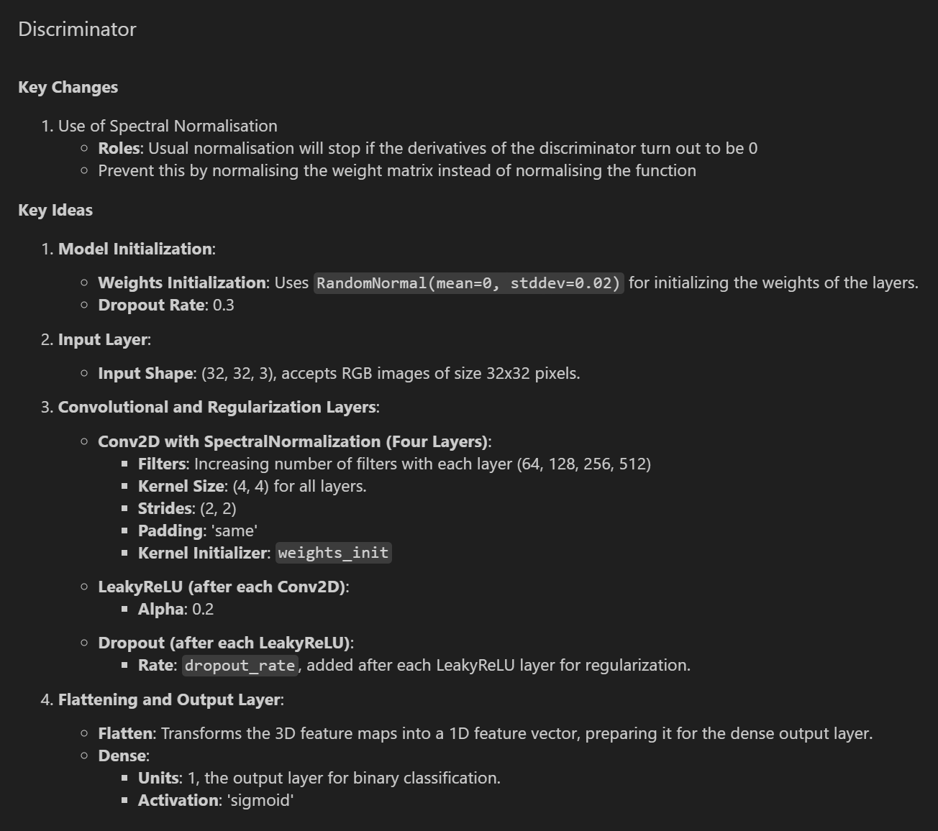
DCGAN (Model 4)

Slide 22
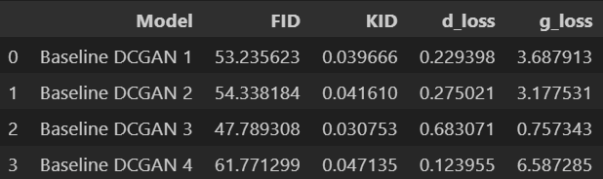
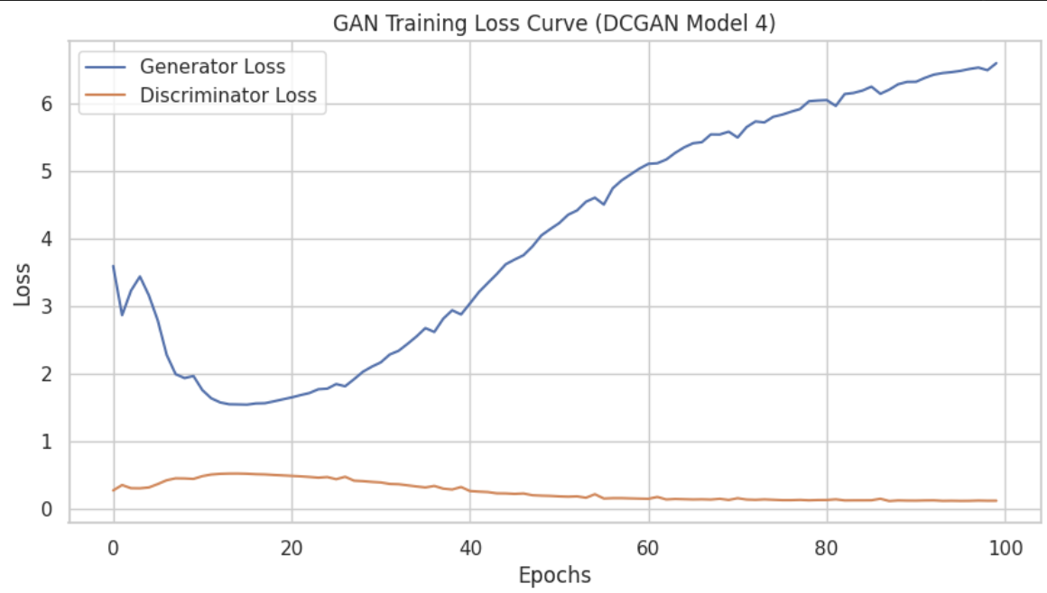
DCGAN (Model 4)
Discriminator loss
For the discriminator loss, it starts relatively low and rises quickly and continues to increase steadily as the epochs increases
Generator loss
For the generator loss, it increases with a spike and drops and proceeded to increase slowly
- FID Score of 62
- KID Score is 0.047
It is not too good, let us see if we can improve
Generally, we can tell most of the animal images like deer, dog but cars and ships images are not produced

Slide 23
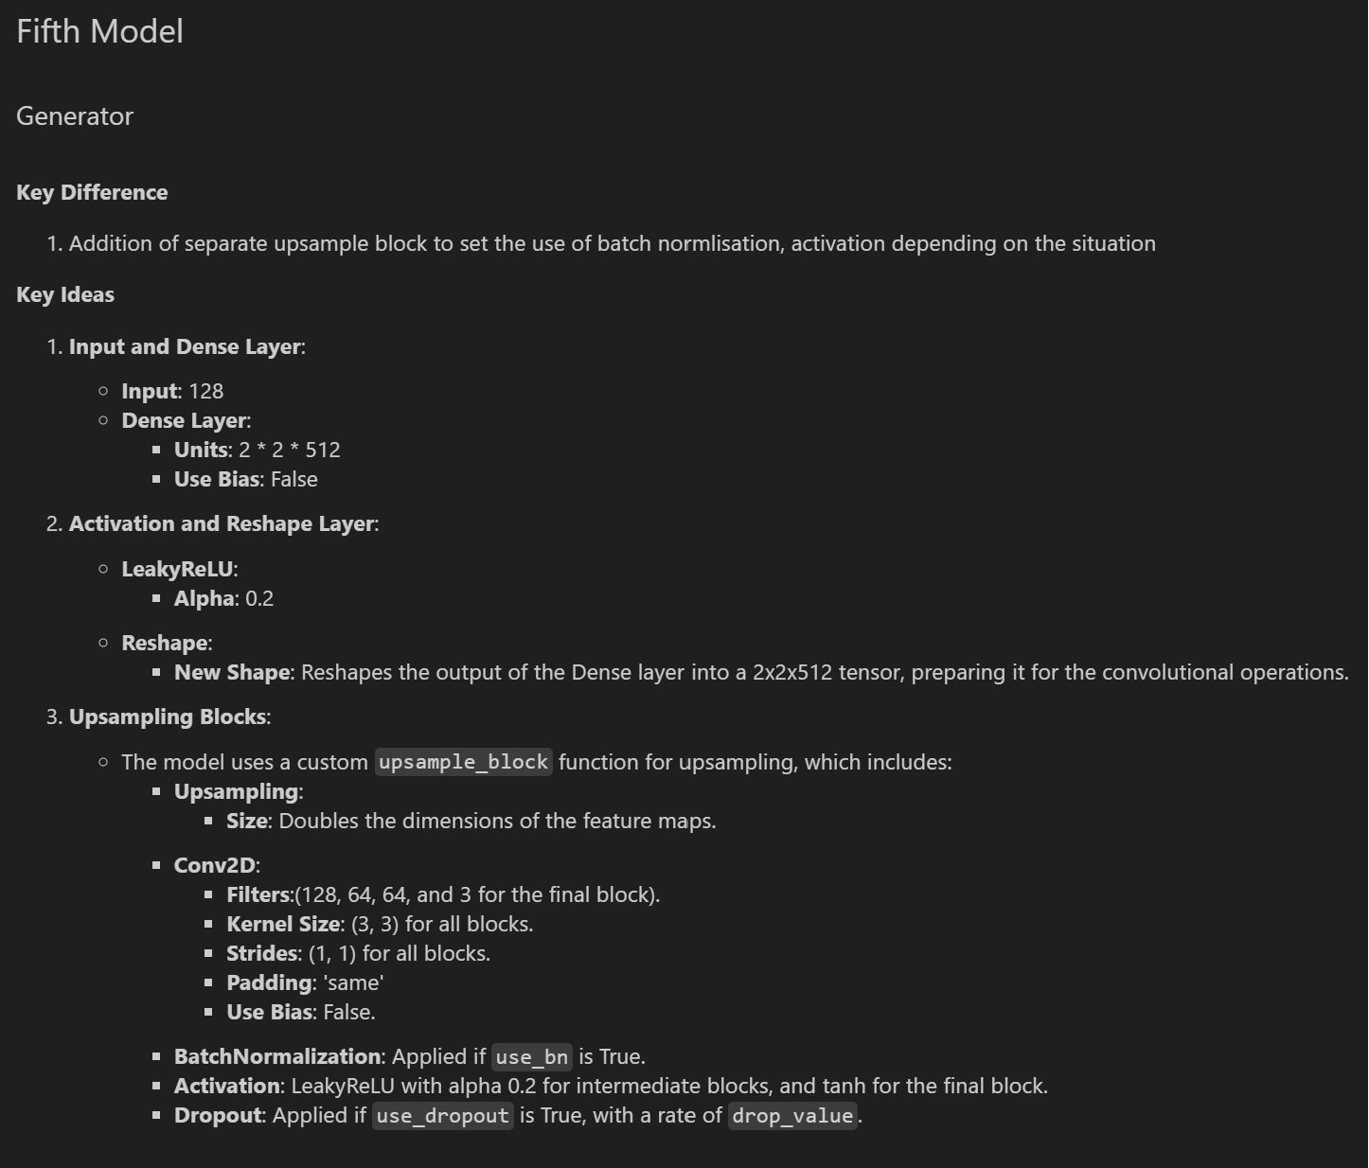
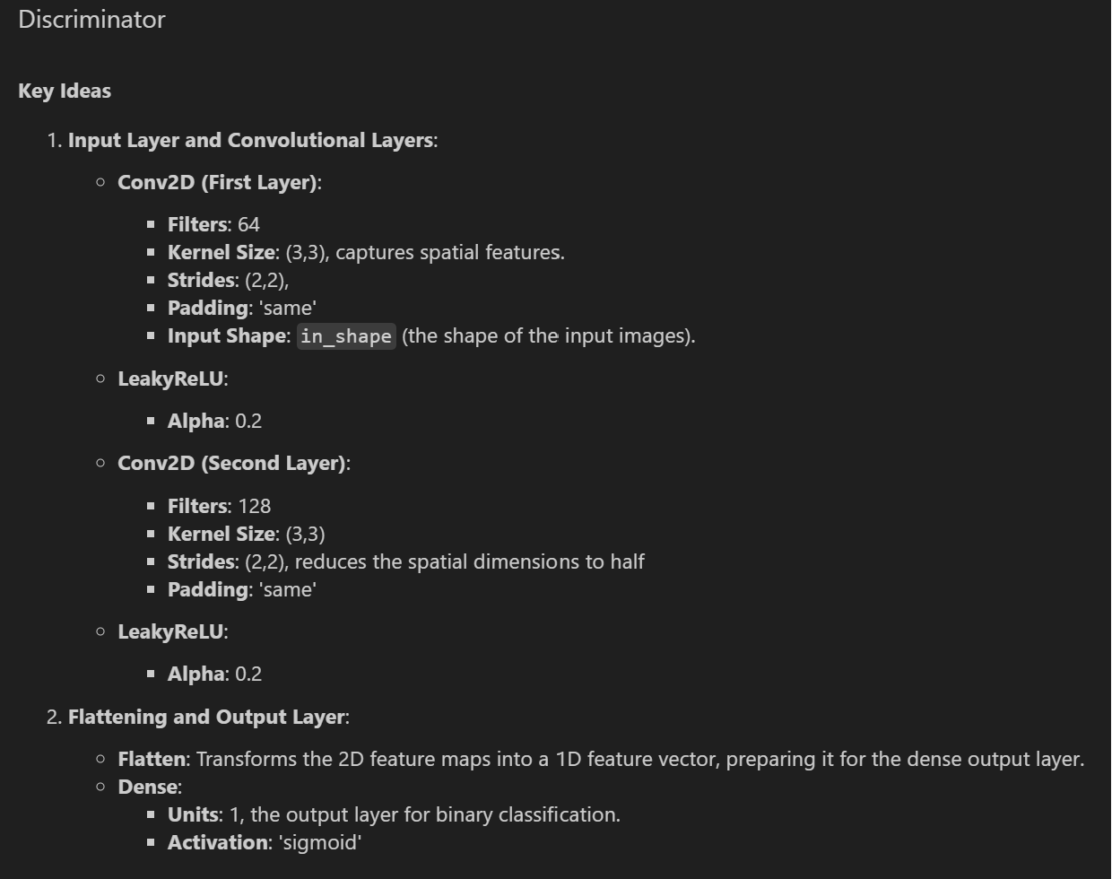
DCGAN (Model 5)

Slide 24
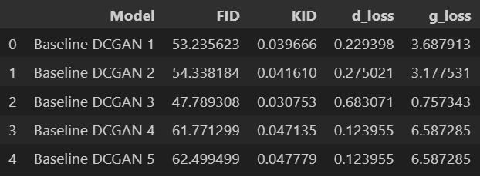
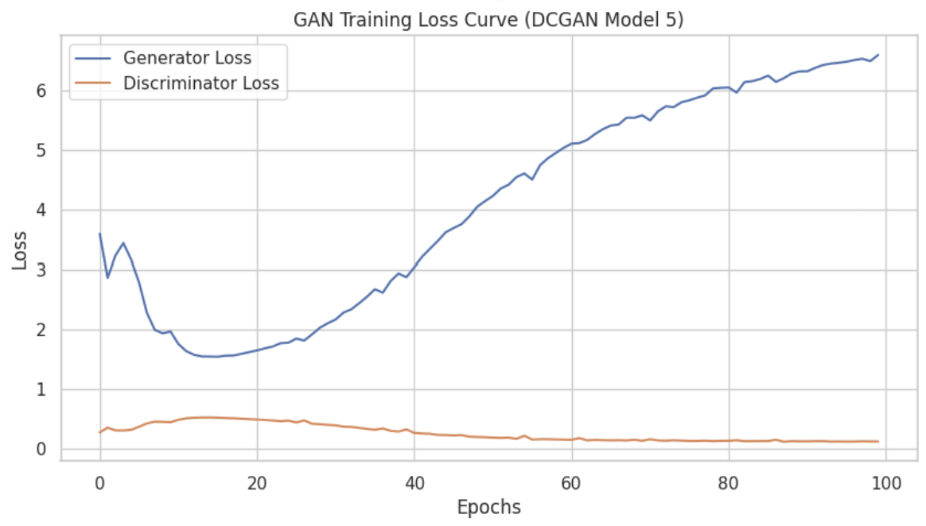
DCGAN (Model 5)
Discriminator loss
For the discriminator loss, it starts relatively low and rises quickly and continues to increase steadily as the epochs increases
Generator loss
For the generator loss, it increases with a spike and drops and proceeded to increase slowly
- FID Score of 62
- KID Score is 0.04
Both are not too good, showing this did not work
Generally, we can tell most of the animal images like deer, dog but cars and ships images are not produced

Slide 25
CGAN

Slide 26
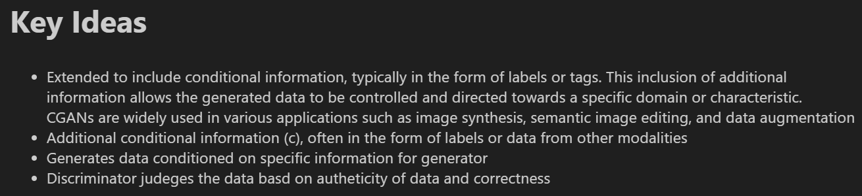
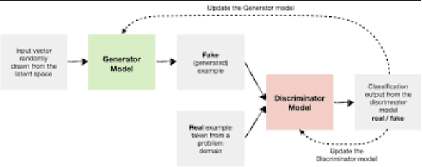
CGAN

Slide 27
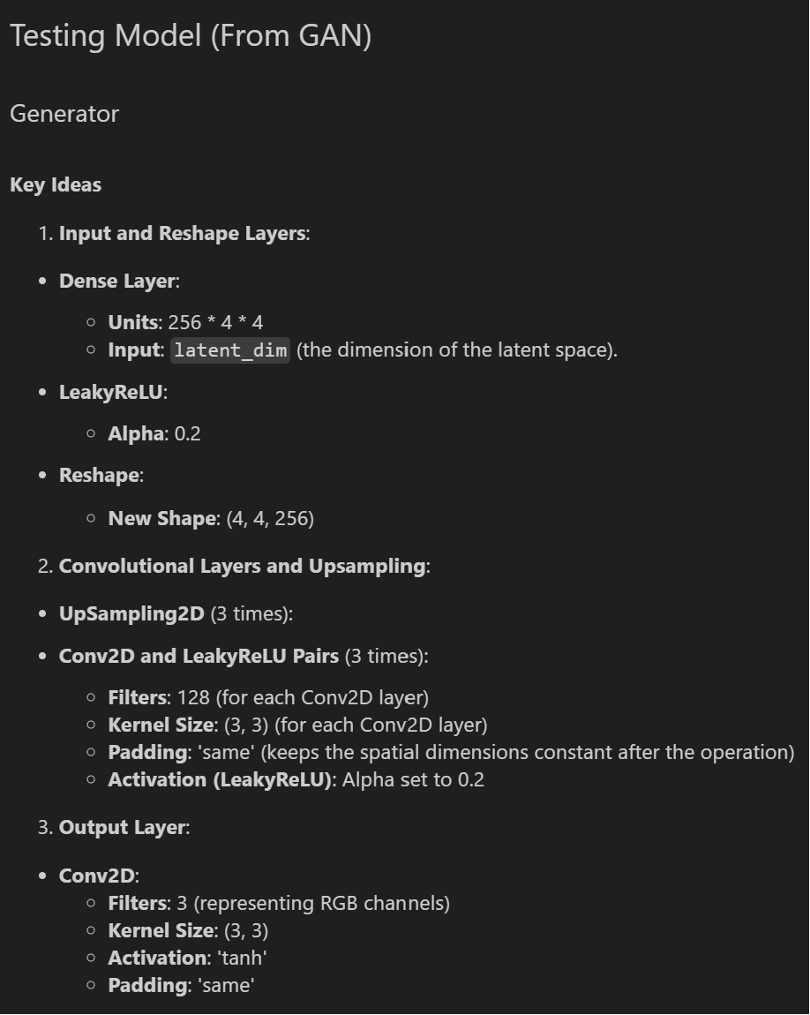
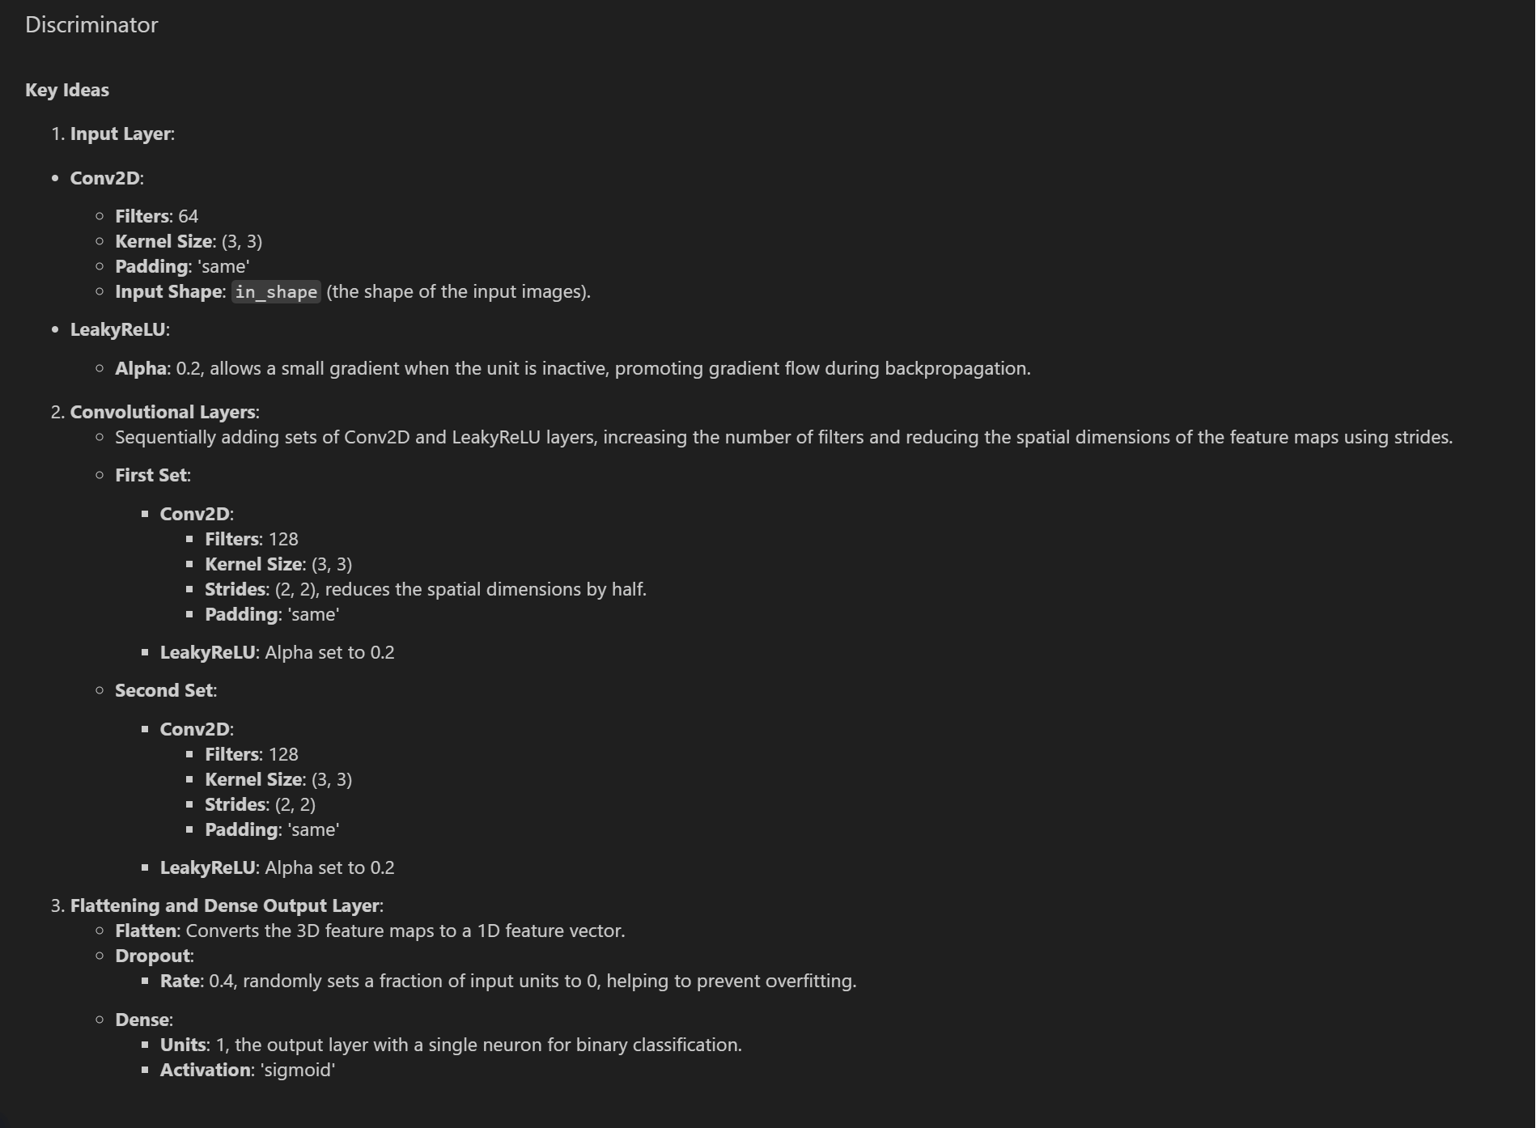
CGAN (Testing Model)

Slide 28
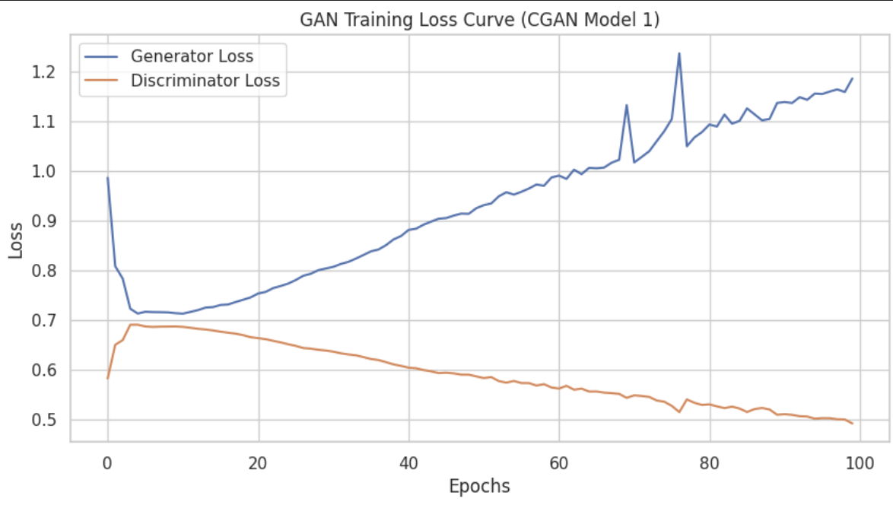
CGAN (Testing Model)
Discriminator loss
For the discriminator loss, it starts relatively low and rises quickly and continues to decrease steadily as the epochs increases
Generator loss
For the generator loss, it drops and proceeded to increase slowly
- FID Score of 55
- KID Score is 0.04
Both are not too good
1000 images provided similar idea compared to comparing it with a classifier but model really collapsed

Slide 29
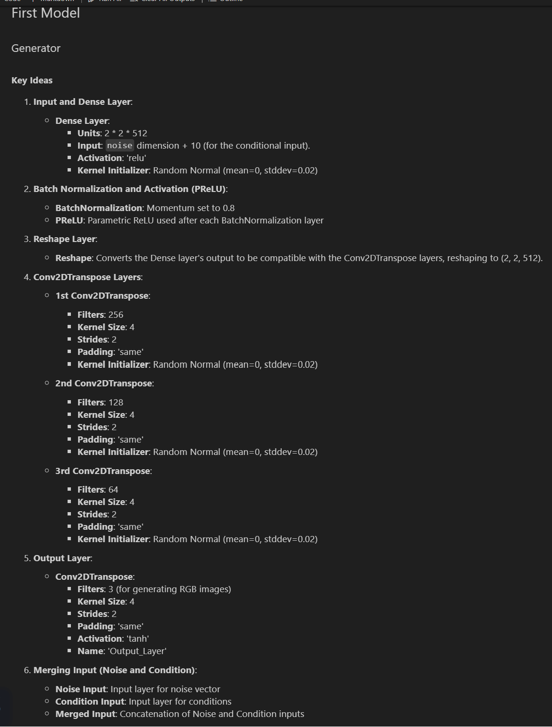
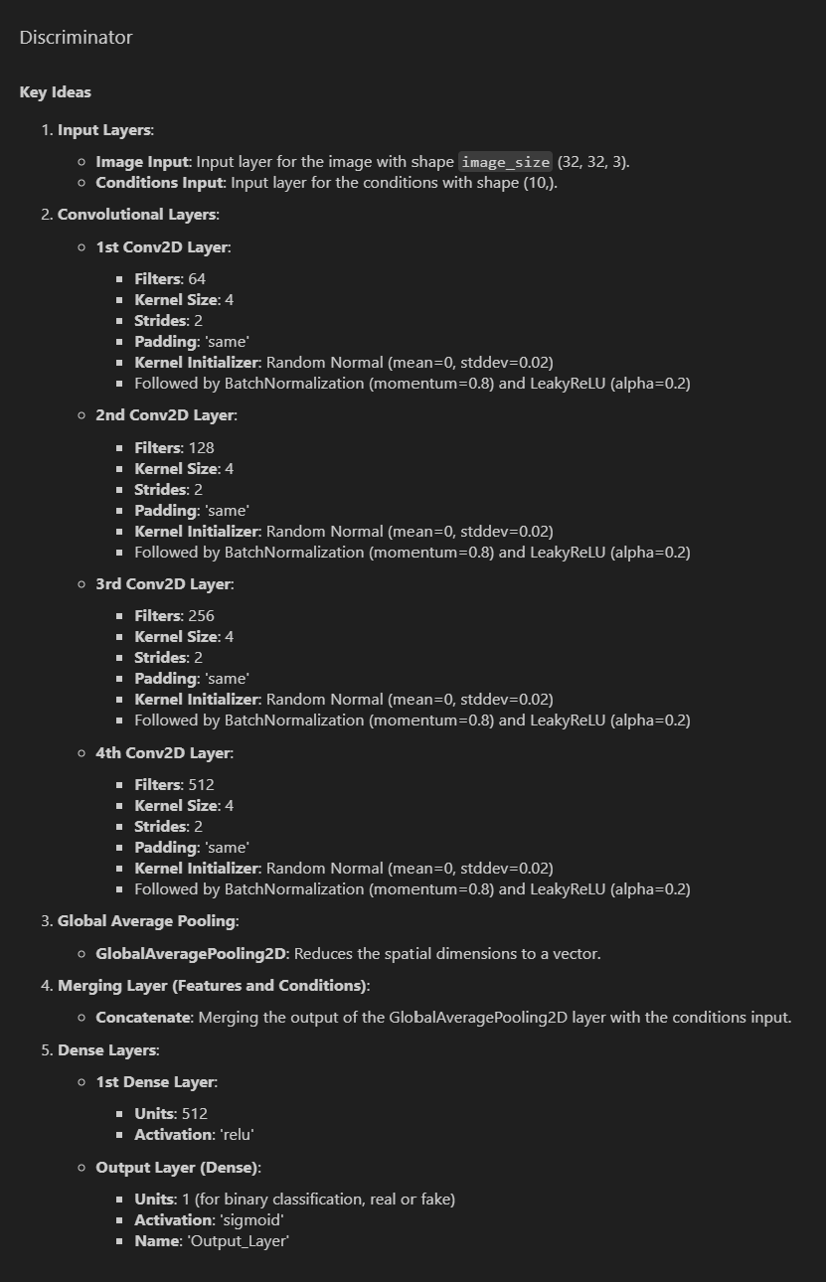
CGAN (Model 1)

Slide 30
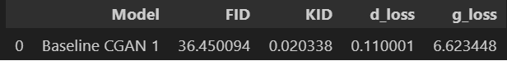
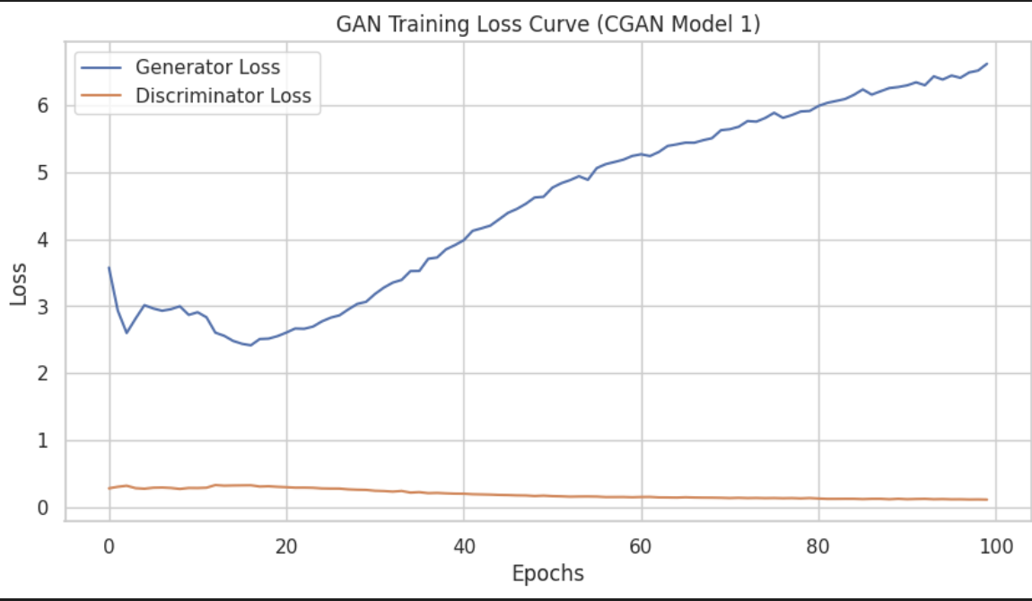
CGAN (Model 1)
Discriminator loss
For the discriminator loss, it starts relatively low and mains around there
Generator loss
For the generator loss, it increases with a drops then proceeded to increase slowly
- FID Score of 36
- KID Score is 0.02
It did improve and currently the best model
1000 images provided similar idea compared to comparing it with a classifier

Slide 31
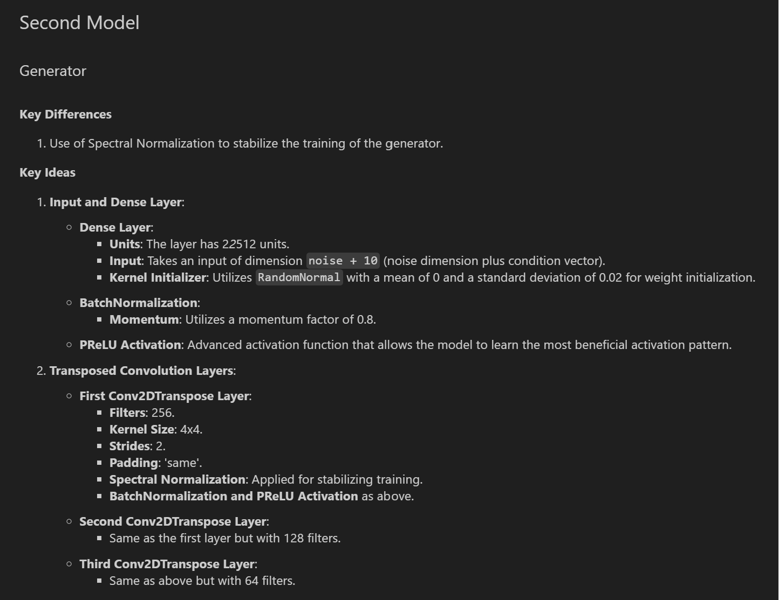
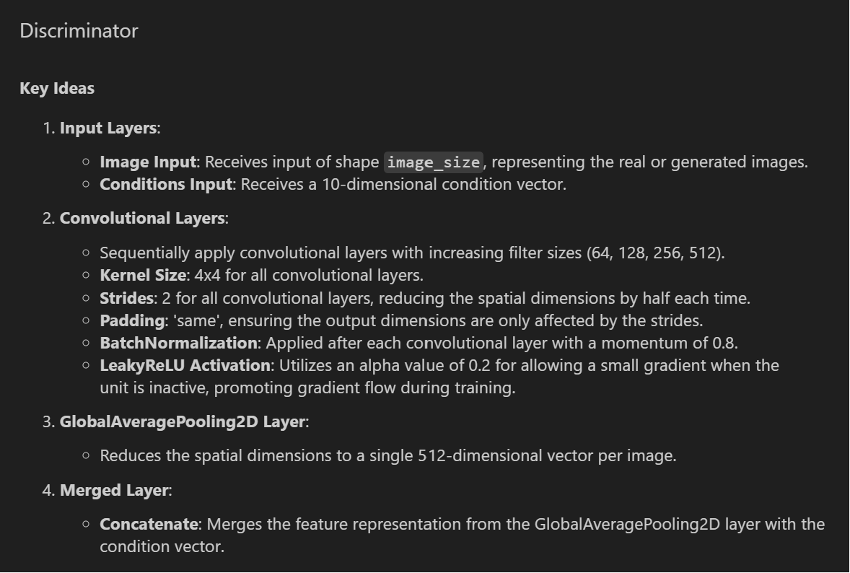
CGAN (Model 2)

Slide 32
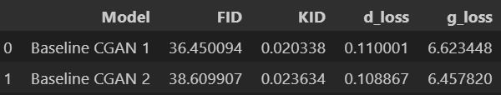
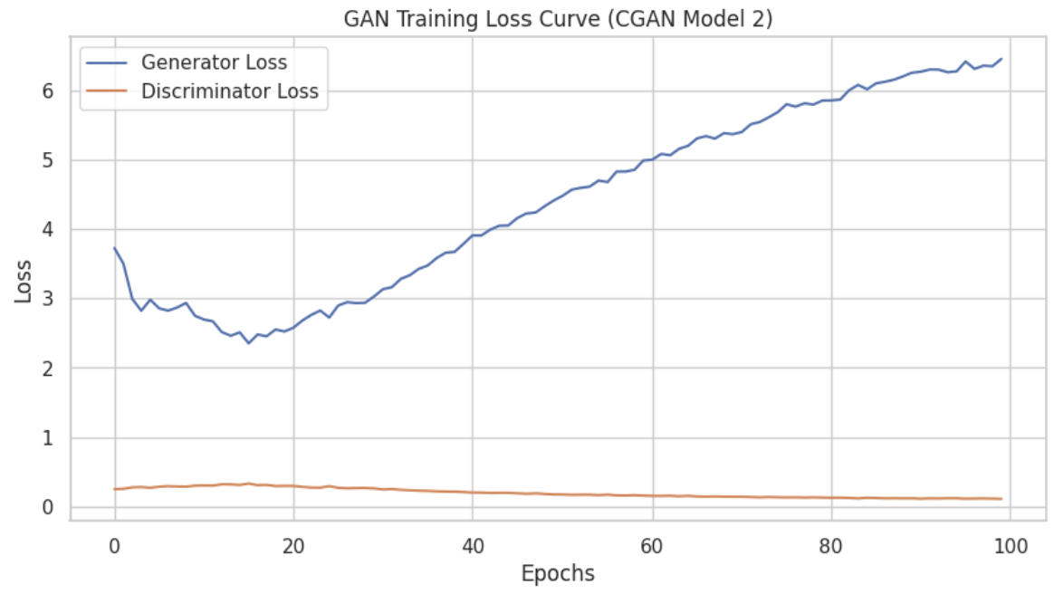
CGAN (Model 2)
Discriminator loss
For the discriminator loss, it starts relatively low and mains around there
Generator loss
For the generator loss, it starts off with drops then proceeded to increase slowly
- FID Score of 39
- KID Score is 0.02
It did not improved further compared to the previous two models
No model collapse

Slide 33
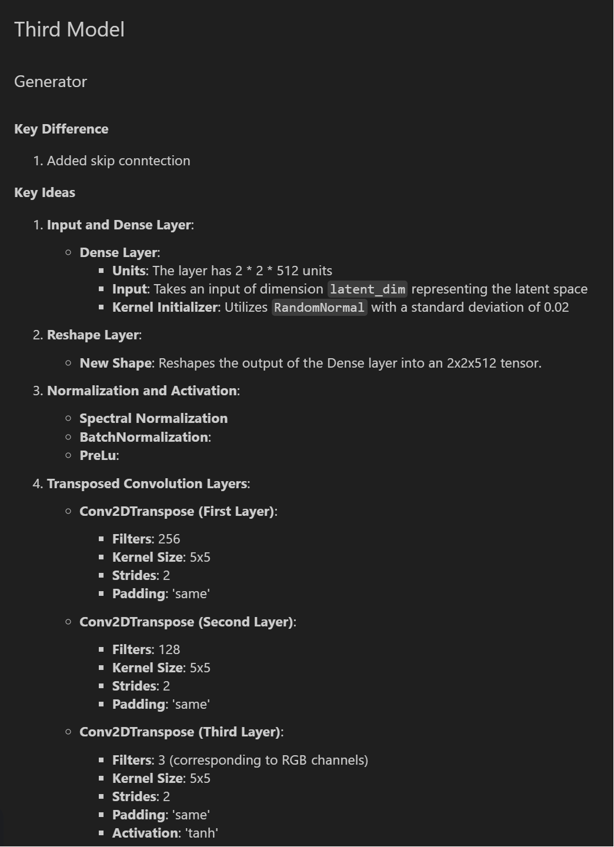
CGAN (Model 3)

Slide 34
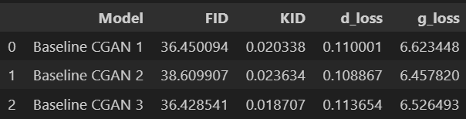
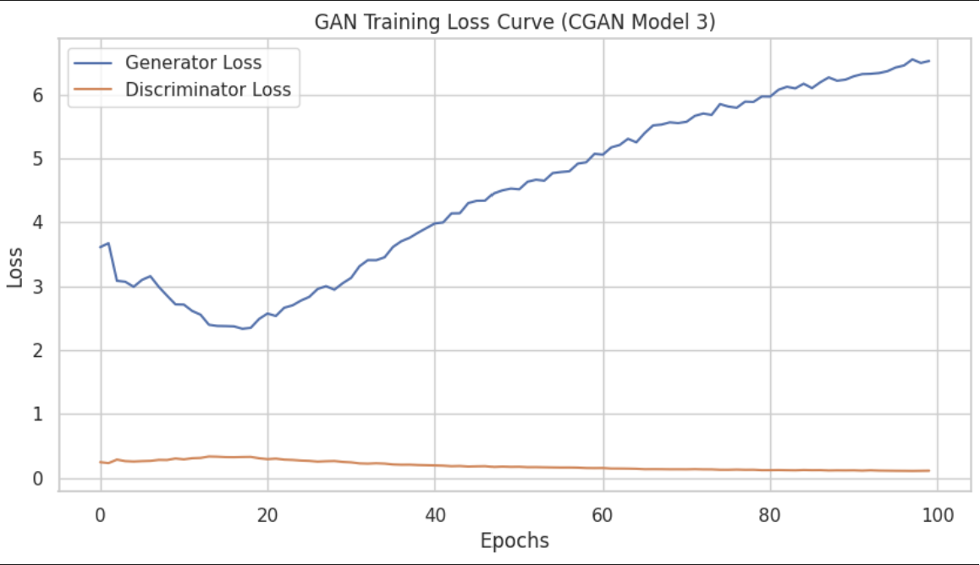
CGAN (Model 3)
Discriminator loss
For the discriminator loss, it starts relatively low and remains stagnant with a slight decrease as epoch increases.
Generator loss
For the generator loss, it drops then proceeded to increase slowly
- FID Score of 36
- KID Score is 0.018
It improved further compared to the previous two models

Slide 35
WGAN

Slide 36
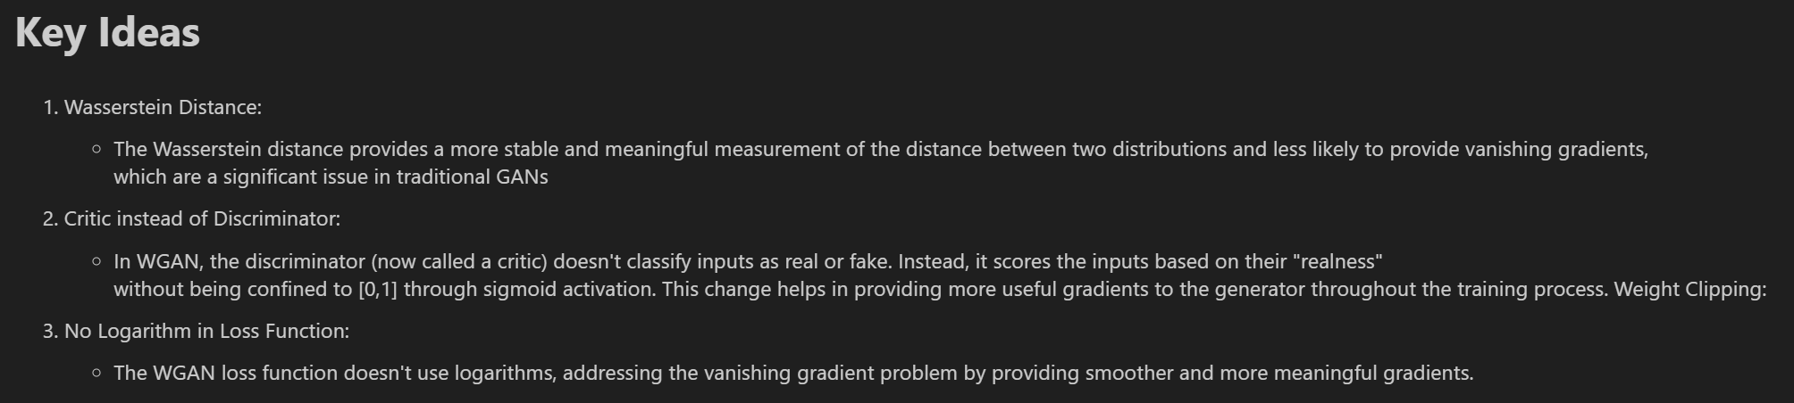
WGAN

Slide 37
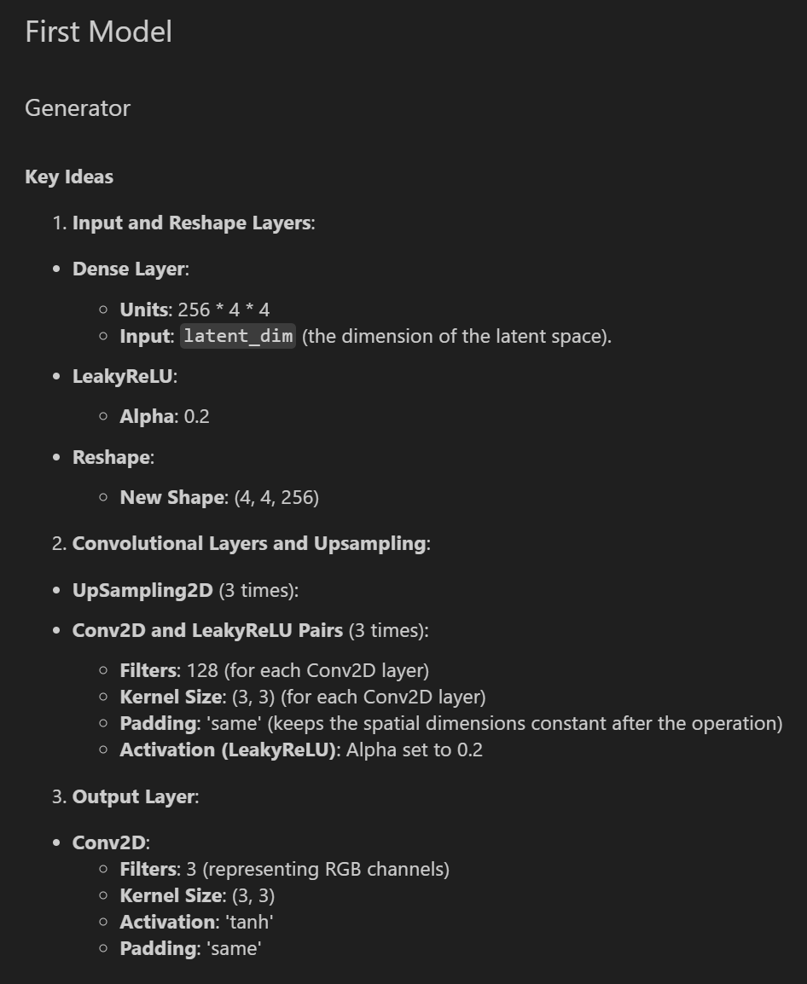
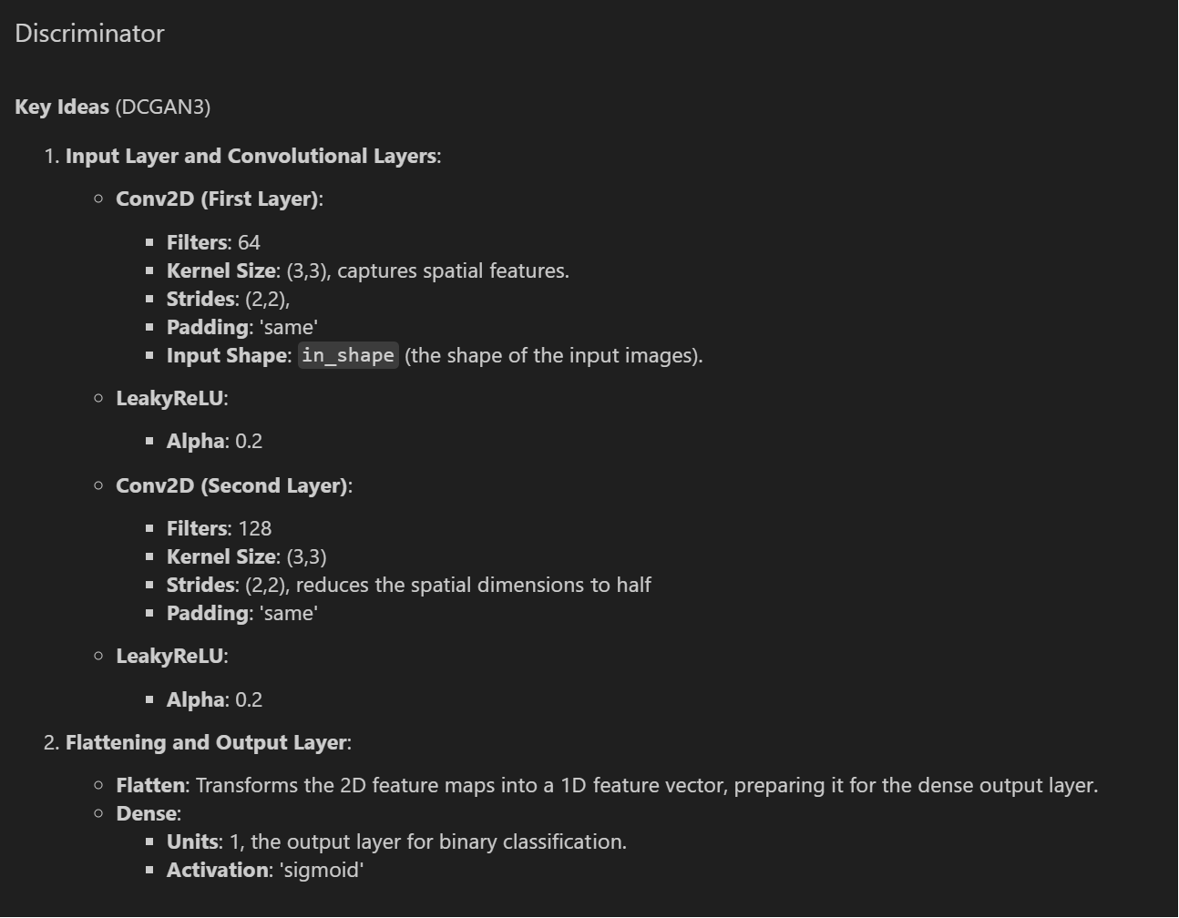
WGAN (Model 1)

Slide 38
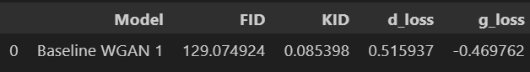

WGAN (Model 1)
Discriminator loss
For the discriminator loss, it maintains pretty constant here.
Generator loss
For the generator loss, it maintains pretty stable here
- FID Score of 129
- KID Score is 0.08
Worse than DCGAN here
- 1000 images provided showing actually model collapse happened

Slide 39


WGAN (Model 2)

Slide 40


WGAN (Model 2)
Discriminator loss
For the discriminator loss, it fluctuates
Generator loss
For the generator loss, it fluctutates
- FID Score of 182
- KID Score is 0.19
It is not too good, worse than DCGAN
Overall, WGAN did not improve our score and not producing good images

Slide 41
SADCGAN

Slide 42

SADCGAN

Slide 43


SADCGAN (Model 1)

Slide 44


SADCGAN (Model 1)
Discriminator loss
For the discriminator loss, it starts relatively low and mains around there
Generator loss
For the generator loss, it increases with a spike and drops and proceeded to increase slowly
- FID Score of 50
- KID Score is 0.04
Did have a minor improvement over baseline dcgan 2
Similar to above, we can tell most of the animal images like deer,with some other classes also seen

Slide 45


SADCGAN (Model 2)

Slide 46


SADCGAN (Model 2)
Discriminator loss
For the discriminator loss, it starts relatively low and rises quickly and continues to decrease steadily as the epochs increases
Generator loss
For the generator loss, it drops and proceeded to increase slowly
- FID Score of 49
- KID Score is 0.047
It did not improve too much.

Slide 47
04
Evaluation

Slide 48

Evaluation Metrics

Slide 49


Evaluation Metrics

Slide 50
05
Model Improvement
We will further improve CGAN model 1 and DCGAN model 3

Slide 51
Model Improvement - Outlier Testing
Outlier testing in GANs is crucial for ensuring the generative model produces high-quality and diverse outputs, identifying instances where the model deviates significantly from the expected data distribution.
By integrating outlier detection mechanisms, researchers can monitor and improve the stability of GAN training, mitigating common issues like mode collapse, where the model generates limited varieties of outputs.
Techniques like statistical outlier detection, distance metrics in latent space, or comparison against a validation set are commonly used to identify anomalies in the data generated by GANs.
Incorporating outlier testing into the GAN framework not only enhances the reliability of the model but also provides valuable insights into the model's learning dynamics and potential areas for improvement
This is done with the use of auto encoder
Auto Encoder are a type of deep-learning architectures that are used to learn how to compress and decompress data faithfully.
The compression layers are referred to as the encoding layers, and the decompression layers are referred to as the decoding layer

Slide 52

Model Improvement - Outlier Testing
Outlier image seems to be mix with half clear and half unclear

Slide 53
Model Improvement - Sharpening Image
Sharpening images in GANs is a post-processing step aimed at enhancing the clarity and detail of generated images, often addressing common issues like blurriness or lack of texture definition
This technique involves applying image processing filters, such as unsharp masking or high-pass filters, to emphasize edges and fine details, making the generated images more realistic and visually appealing
Image sharpening can be particularly beneficial in applications where GANs are used for super-resolution tasks, converting low-resolution images to high-resolution counterparts while maintaining high-quality details
Incorporating sharpening techniques into GAN frameworks can also aid in improving the perceptual quality of generated images, making them more convincing to the human eye and useful for practical applications

Slide 54

Model Improvement - Sharpening Image
Image are sharpened even clearer here

Slide 55
Model Improvement - Data Augmentation
Data augmentation in GANs involves artificially expanding the dataset by generating altered versions of the training images, utilizing techniques such as rotation, width and height shifts, and horizontal flipping, as seen by ImageDataGenerator
By applying transformations like a 15-degree rotation range, 10% width and height shift range, and enabling horizontal flips, `ImageDataGenerator` enhances the diversity of the training data, helping the model generalize better and reducing overfitting
This augmentation process makes the GAN model more robust to variations in input data, effectively teaching the model to recognize and generate images that maintain their identity despite alterations in orientation, position, and perspective
Incorporating such data augmentation strategies is particularly useful in scenarios where the dataset is limited, as it artificially expands the dataset size, providing the GAN with more varied examples to learn from

Slide 56
Model Improvement - CutMix
The idea of cutmix is to base on the labels mix two different images.
This helps with the discriminator such that the goal is to be able to learn more with less through this process
However, this could result in generated images being unrealistic with cutout portion

Slide 57
Model Improvement - OverSampling
The idea here is to oversample the dataset that we have
The goal is to generate more dataset to be able to have more data to put into training for gan.
Resample from sklearn was used to oversample the data here
The process was first done on the train data

Slide 58
Model Improvement - OverSampling
The idea here is to oversample the dataset that we have
The goal is to generate more dataset to be able to have more data to put into training for gan.
Resample from sklearn was used to oversample the data here
The process was first done on the train data

Slide 59
Model Improvement - Cosine and Exponential Decay
Cosine Decay Scheduler
Cosine decay reduces the learning rate in cosine wave pattern, slowing down at the beginning and end of training.
The idea is to start with an initial learning rate and then reduce it which at the start descends slowly and more steeply in the middle.
This approach is suitable for training neural networks as it combines both rapid and slow decay of learning rate
Exponential Decay Scheduler
The idea here is to oversample the dataset that we have
Exponential decay reduces the learning rate exponentially where the rate is decreasing at a exponential rate
Very useful in cases where one wants to rapidly decrease the learning rate
Learning rate is a fraction of the previous learning rate here

Slide 60


Scores After Model Improvement

Slide 61


Stable Diffusion VS CGAN 1
Stable Diffusion
CGAN 1
OVERALL: CGAN Produces better image overall but stable diffusion potential is huge as this is just a baseline basic model here

Slide 62
06
Final Model
For our final model, we will choose
CGAN 1 (Exponential Decay).

Slide 63


Final Images
Airplane
Automobile

Slide 64


Final Images
Cat
Bird

Slide 65


Final Images
Dog
Deer

Slide 66


Final Images
Frog
Horse

Slide 67


Final Images
Ship
Truck

Slide 68
Thank You!

